Slide 1
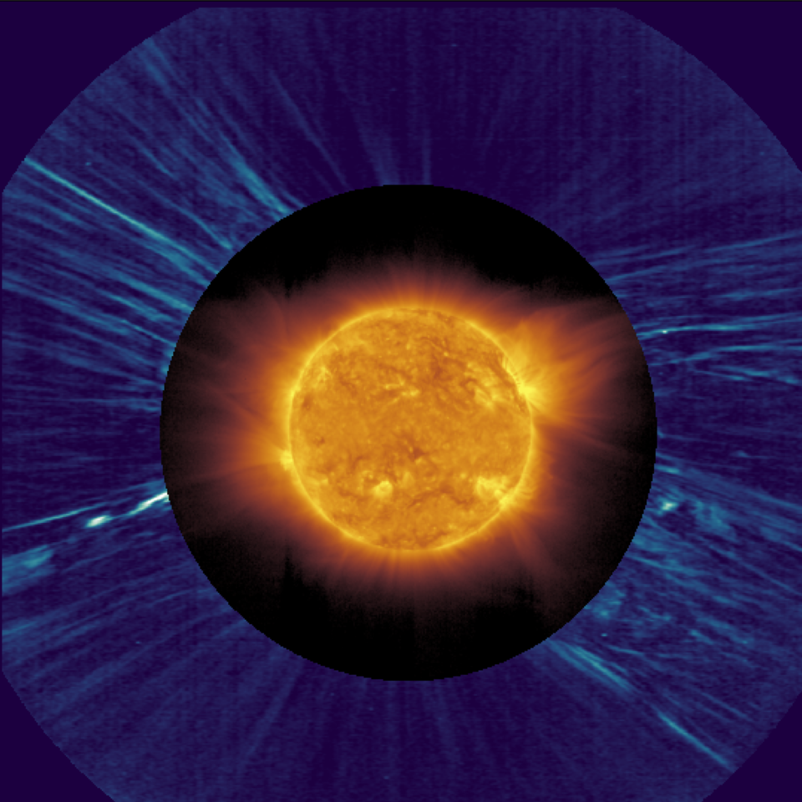







Parametric simulations of the propagation of solar jets:
Investigating the origin of switchbacks
J. Touresse¹, E. Pariat¹, C. Froment², V. Aslanyan³, P. Wyper⁴
¹ LPP, Sorbonne University, ² LPC2E, ³ University of Dundee, ⁴ Durham University
D. Telloni et al. 22
Metis, EUI Imager (SolO)
  Ph.D. funded by IPI, Sorbonne University PNST Conference – 08/01/2024

Slide 2
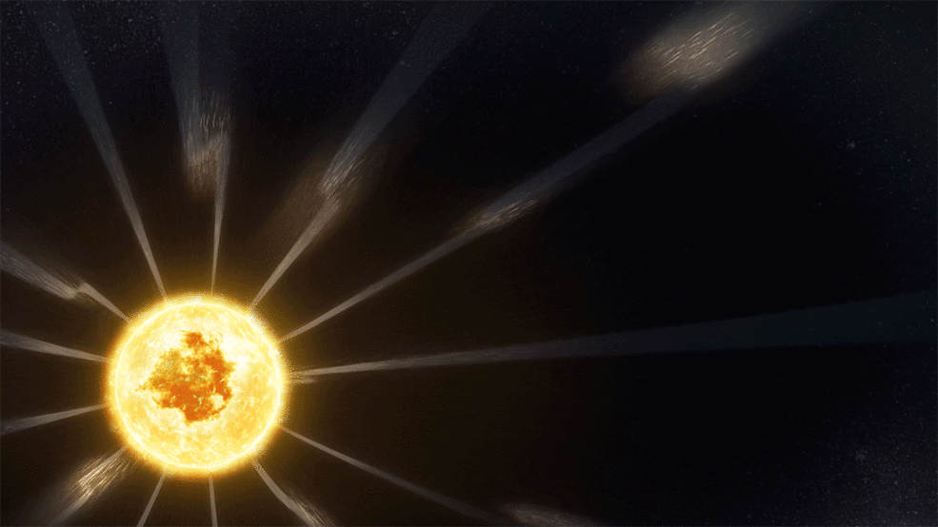
Switchbacks: ubiquitous phenomena in inner heliosphere
Parker Solar Probe (PSP) striking discovery : intermittent magnetic deflections are ubiquitous near the Sun
Dudok de Wit et al. 2020
Artist’s view (NASA)
PNST Conference - 08/01/2024 J. Touresse 2/12

Slide 3


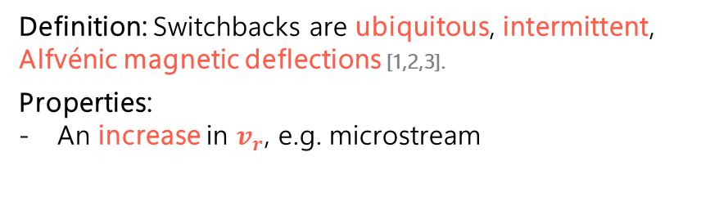







Switchbacks: ubiquitous phenomena in inner heliosphere
Parker Solar Probe (PSP) striking discovery : intermittent magnetic deflections are ubiquitous near the Sun
Dudok de Wit et al. 2020
Definition: Switchbacks are ubiquitous, intermittent, Alfvénic magnetic deflections [1,2,3].
Properties:
An increase in $v_{r}$, e.g. microstream
Artist’s view (NASA)
B [$nT$]
$$B_{R}$$
$$B_{T}$$
$$B_{N}$$
$$\left|B\right|$$
V [$km.s^{−1}$]
$${ V}_{R}−\left\langle V_{R}\right\rangle$$
$$V_{T}$$
$$V_{N}$$
[1] Farell et al. 2020
[2] Larosa et al. 2021
[3] Bizien et al. 2023
Zoom on an individual switchback Froment et al. 2021
PNST Conference - 08/01/2024 J. Touresse 2/12

Slide 4


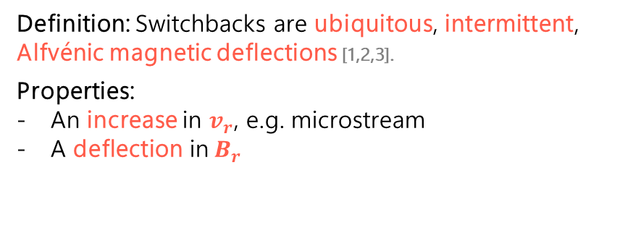





Switchbacks: ubiquitous phenomena in inner heliosphere
Parker Solar Probe (PSP) striking discovery : intermittent magnetic deflections are ubiquitous near the Sun
Dudok de Wit et al. 2020
Definition: Switchbacks are ubiquitous, intermittent, Alfvénic magnetic deflections [1,2,3].
Properties:
An increase in $v_{r}$, e.g. microstream
A deflection in $B_{r}$
Artist’s view (NASA)
B [$nT$]
$$B_{R}$$
$$B_{T}$$
$$B_{N}$$
$$\left|B\right|$$
V [$km.s^{−1}$]
$${ V}_{R}−\left\langle V_{R}\right\rangle$$
$$V_{T}$$
$$V_{N}$$
[1] Farell et al. 2020
[2] Larosa et al. 2021
[3] Bizien et al. 2023
Zoom on an individual switchback Froment et al. 2021
PNST Conference - 08/01/2024 J. Touresse 2/12

Slide 5
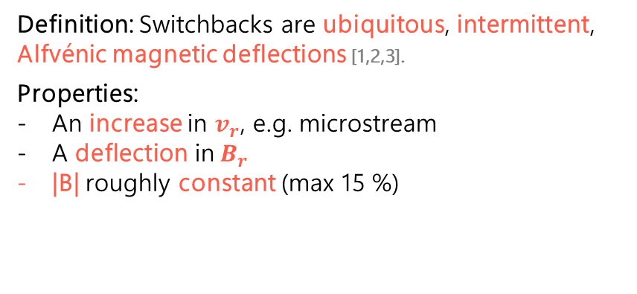
Switchbacks: ubiquitous phenomena in inner heliosphere
Parker Solar Probe (PSP) striking discovery : intermittent magnetic deflections are ubiquitous near the Sun
Dudok de Wit et al. 2020
Definition: Switchbacks are ubiquitous, intermittent, Alfvénic magnetic deflections [1,2,3].
Properties:
An increase in $v_{r}$, e.g. microstream
A deflection in $B_{r}$
|B| roughly constant (max 15 %)
Artist’s view (NASA)
B [$nT$]
$$B_{R}$$
$$B_{T}$$
$$B_{N}$$
$$\left|B\right|$$
V [$km.s^{−1}$]
$${ V}_{R}−\left\langle V_{R}\right\rangle$$
$$V_{T}$$
$$V_{N}$$
[1] Farell et al. 2020
[2] Larosa et al. 2021
[3] Bizien et al. 2023
Zoom on an individual switchback Froment et al. 2021
PNST Conference - 08/01/2024 J. Touresse 2/12

Slide 6
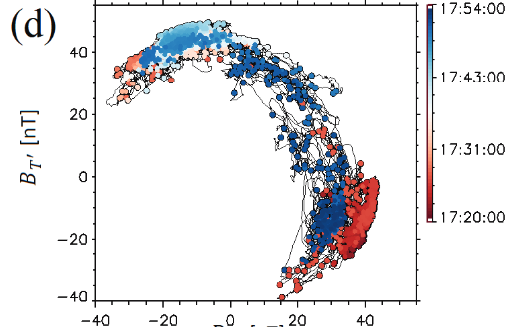
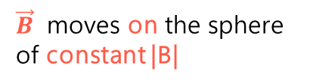


Switchbacks: ubiquitous phenomena in inner heliosphere
Parker Solar Probe (PSP) striking discovery : intermittent magnetic deflections are ubiquitous near the Sun
Dudok de Wit et al. 2020
Definition: Switchbacks are ubiquitous, intermittent, Alfvénic magnetic deflections [1,2,3].
Properties:
An increase in $v_{r}$, e.g. microstream
A deflection in $B_{r}$
|B| roughly constant (max 15 %)
Artist’s view (NASA)
$\vec{B}$ moves on the sphere of constant |B|
B [$nT$]
$$B_{R}$$
$$B_{T}$$
$$B_{N}$$
$$\left|B\right|$$
V [$km.s^{−1}$]
$${ V}_{R}−\left\langle V_{R}\right\rangle$$
$$B_{T′} [nT]$$
$$V_{T}$$
$$V_{N}$$
[1] Farell et al. 2020
[2] Larosa et al. 2021
[3] Bizien et al. 2023
Zoom on an individual switchback Froment et al. 2021
$$B_{R′} [nT]$$
Drake et al. 2021
PNST Conference - 08/01/2024 J. Touresse 2/12

Slide 7
Switchbacks: ubiquitous phenomena in inner heliosphere
Parker Solar Probe (PSP) striking discovery : intermittent magnetic deflections are ubiquitous near the Sun
Dudok de Wit et al. 2020
Definition: Switchbacks are ubiquitous, intermittent, Alfvénic magnetic deflections [1,2,3].
Properties:
An increase in $v_{r}$, e.g. microstream
A deflection in $B_{r}$
|B| roughly constant (max 15 %)
Artist’s view (NASA)
$\vec{B}$ moves on the sphere of constant |B|
B [$nT$]
$$B_{R}$$
$$B_{T}$$
$$B_{N}$$
$$\left|B\right|$$
V [$km.s^{−1}$]
$${ V}_{R}−\left\langle V_{R}\right\rangle$$
$$B_{T′} [nT]$$
$$V_{T}$$
$$V_{N}$$
[1] Farell et al. 2020
[2] Larosa et al. 2021
[3] Bizien et al. 2023
Zoom on an individual switchback Froment et al. 2021
$$B_{R′} [nT]$$
Drake et al. 2021
PNST Conference - 08/01/2024 J. Touresse 2/12

Slide 8

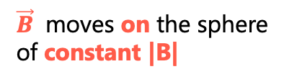




Switchbacks: ubiquitous phenomena in inner heliosphere
Parker Solar Probe (PSP) striking discovery : intermittent magnetic deflections are ubiquitous near the Sun
Dudok de Wit et al. 2020
Definition: Switchbacks are ubiquitous, intermittent, Alfvénic magnetic deflections [1,2,3].
Properties:
An increase in $v_{r}$, e.g. microstream
A deflection in $B_{r}$
|B| roughly constant (max 15 %)
Artist’s view (NASA)
$\vec{B}$ moves on the sphere of constant |B|
B [$nT$]
$$B_{R}$$
$$B_{T}$$
$$B_{N}$$
$$\left|B\right|$$
V [$km.s^{−1}$]
$${ V}_{R}−\left\langle V_{R}\right\rangle$$
$$B_{T′} [nT]$$
$$V_{T}$$
$$V_{N}$$
55 °
[1] Farell et al. 2020
[2] Larosa et al. 2021
[3] Bizien et al. 2023
Zoom on an individual switchback Froment et al. 2021
$$B_{R′} [nT]$$
Drake et al. 2021
PNST Conference - 08/01/2024 J. Touresse 2/12

Slide 9
Switchbacks: ubiquitous phenomena in inner heliosphere
Parker Solar Probe (PSP) striking discovery : intermittent magnetic deflections are ubiquitous near the Sun
Dudok de Wit et al. 2020
Definition: Switchbacks are ubiquitous, intermittent, Alfvénic magnetic deflections [1,2,3].
Properties:
An increase in $v_{r}$, e.g. microstream
A deflection in $B_{r}$
|B| roughly constant (max 15 %)
Artist’s view (NASA)
$\vec{B}$ moves on the sphere of constant |B|
B [$nT$]
$$B_{R}$$
$$B_{T}$$
$$B_{N}$$
$$\left|B\right|$$
V [$km.s^{−1}$]
$${ V}_{R}−\left\langle V_{R}\right\rangle$$
$$B_{T′} [nT]$$
$$V_{T}$$
$$V_{N}$$
145 °
[1] Farell et al. 2020
[2] Larosa et al. 2021
[3] Bizien et al. 2023
Zoom on an individual switchback Froment et al. 2021
$$B_{R′} [nT]$$
Drake et al. 2021
PNST Conference - 08/01/2024 J. Touresse 2/12

Slide 10
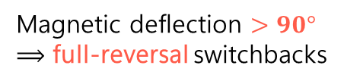
Switchbacks: ubiquitous phenomena in inner heliosphere
Parker Solar Probe (PSP) striking discovery : intermittent magnetic deflections are ubiquitous near the Sun
Dudok de Wit et al. 2020
Definition: Switchbacks are ubiquitous, intermittent, Alfvénic magnetic deflections [1,2,3].
Properties:
An increase in $v_{r}$, e.g. microstream
A deflection in $B_{r}$
|B| roughly constant (max 15 %)
Artist’s view (NASA)
$\vec{B}$ moves on the sphere of constant |B|
B [$nT$]
$$B_{R}$$
$$B_{T}$$
$$B_{N}$$
$$\left|B\right|$$
Magnetic deflection $>90°$
$⟹$ full-reversal switchbacks
V [$km.s^{−1}$]
$${ V}_{R}−\left\langle V_{R}\right\rangle$$
$$B_{T′} [nT]$$
$$V_{T}$$
$$V_{N}$$
200 °
[1] Farell et al. 2020
[2] Larosa et al. 2021
[3] Bizien et al. 2023
Zoom on an individual switchback Froment et al. 2021
$$B_{R′} [nT]$$
Drake et al. 2021
PNST Conference - 08/01/2024 J. Touresse 2/12

Slide 11
Switchbacks: Do switchback have a solar origin?
Two families of scenario:
In situ
Low solar atmosphere
PNST Conference - 08/01/2024 J. Touresse 3/12

Slide 12
Switchbacks: Do switchback have a solar origin?
Two families of scenario:
In situ
Low solar atmosphere
If it is the case, which solar phenomenon can be the progenitor of switchbacks?
PNST Conference - 08/01/2024 J. Touresse 3/12

Slide 13
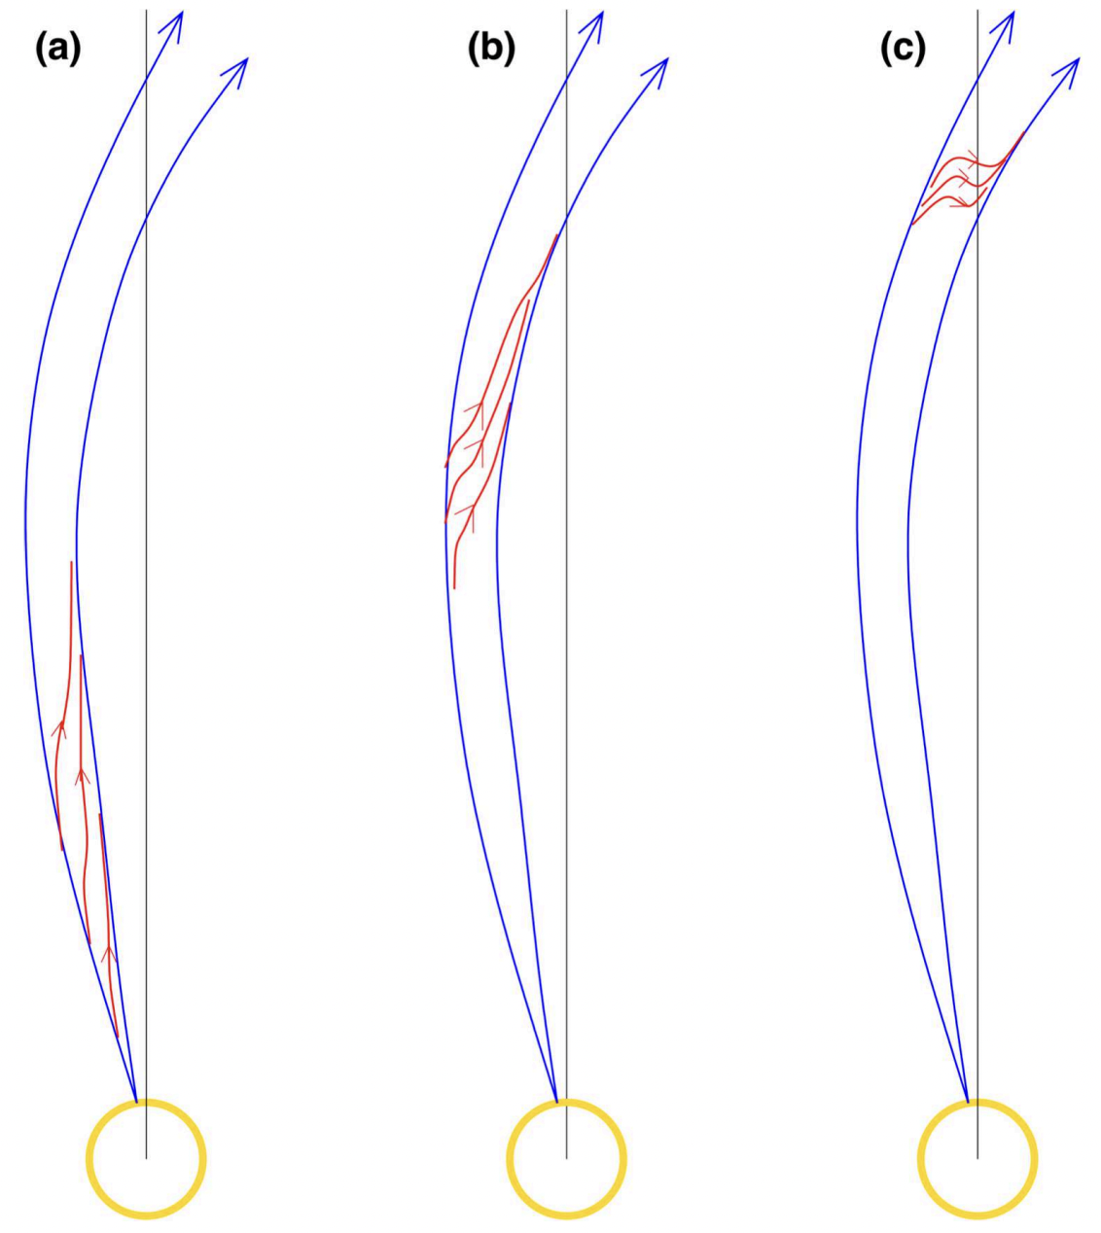
Switchbacks: Do switchback have a solar origin?
Two families of scenario:
In situ
Low solar atmosphere
If it is the case, which solar phenomenon can be the progenitor of switchbacks?
How are the switchbacks generated from the low solar atmosphere?
Akhavan-Tafti et al. 2022
Fisk & Kasper et al. 2020
Sterling & Moore 2020
PNST Conference - 08/01/2024 J. Touresse 3/12

Slide 14
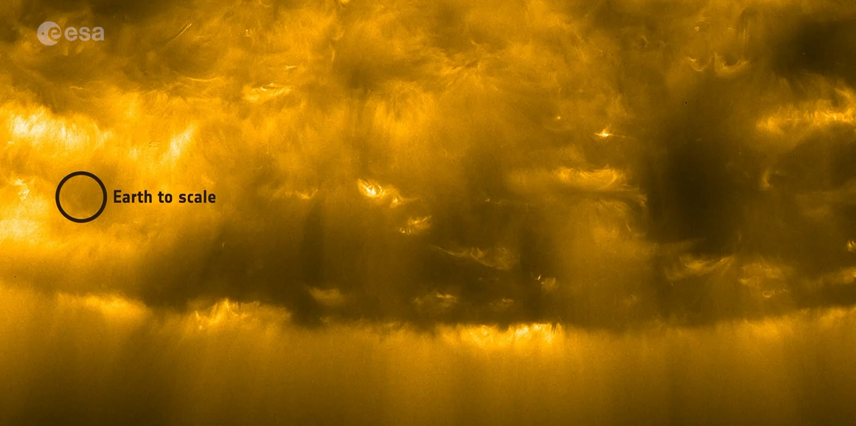
Jets: ubiquitous phenomena in the solar atmophere
Switchbacks (SB) could be induced by jet-like events (Neugebauer et al.2012; Huang et al. 2023; Kumar et al. 2023)
  Coronal jets / Macrospicules: l > 10⁴ km
  Chromospheric jets / surges / jetlets: l ~ 10³ km
  Photospheric jets / spicules : l < 10³ km
UV (EUI/Solar Orbiter)
PNST Conference - 08/01/2024 J. Touresse 4/12

Slide 15
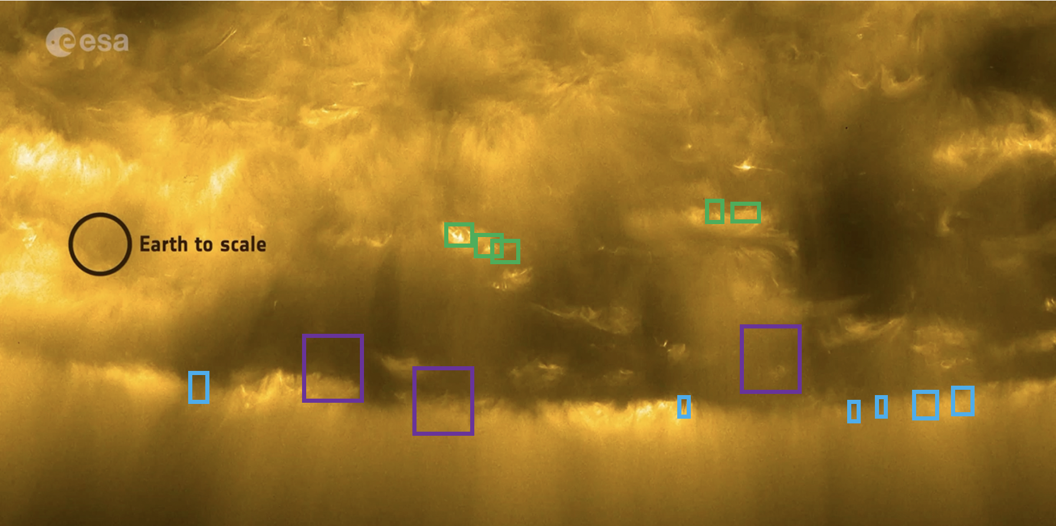
Jets: ubiquitous phenomena in the solar atmophere
Switchbacks (SB) could be induced by jet-like events (Neugebauer et al.2012; Huang et al. 2023; Kumar et al. 2023)
Arguments in favor:
Jets are sharp edged, ubiquitous, collimated & intermittent features
Observed all over the atmosphere (Coronal holes, active regions and quiet Sun)
Observed over a broad range of scales
  Coronal jets / Macrospicules: l > 10⁴ km
  Chromospheric jets / surges / jetlets: l ~ 10³ km
  Photospheric jets / spicules : l < 10³ km
UV (EUI/Solar Orbiter)
PNST Conference - 08/01/2024 J. Touresse 4/12

Slide 16
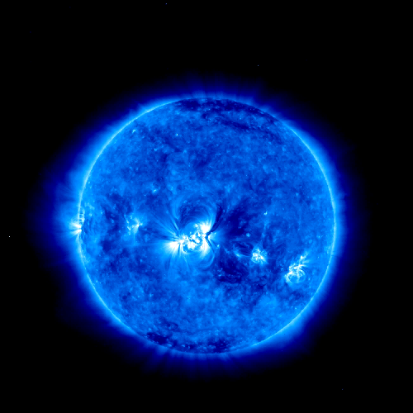
Jets: ubiquitous phenomena in the solar atmophere
Switchbacks (SB) could be induced by jet-like events (Neugebauer et al.2012; Huang et al. 2023; Kumar et al. 2023)
Arguments in favor:
Jets are sharp edged, ubiquitous, collimated & intermittent features
Observed all over the atmosphere (Coronal holes, active regions and quiet Sun)
Observed over a broad range of scales
  Coronal jets / Macrospicules: l > 10⁴ km
  Chromospheric jets / surges / jetlets: l ~ 10³ km
  Photospheric jets / spicules : l < 10³ km
Jets can propagate very far away
UV+White Light (STEREO) Patsourakos et al. 2008
PNST Conference - 08/01/2024 J. Touresse 4/12

Slide 17
Jets: ubiquitous phenomena in the solar atmophere
Switchbacks (SB) could be induced by jet-like events (Neugebauer et al.2012; Huang et al. 2023; Kumar et al. 2023)
Arguments in favor:
Jets are sharp edged, ubiquitous, collimated & intermittent features
Observed all over the atmosphere (Coronal holes, active regions and quiet Sun)
Observed over a broad range of scales
  Coronal jets / Macrospicules: l > 10⁴ km
  Chromospheric jets / surges / jetlets: l ~ 10³ km
  Photospheric jets / spicules : l < 10³ km
Jets can propagate very far away
UV (EUI/Solar Orbiter)
UV+White Light (STEREO) Patsourakos et al. 2008
PNST Conference - 08/01/2024 J. Touresse 4/12

Slide 18
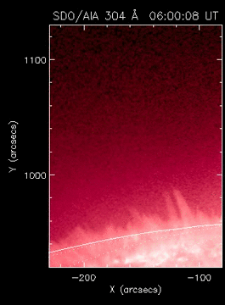
Jets: ubiquitous phenomena in the solar atmophere
Switchbacks (SB) could be induced by jet-like events (Neugebauer et al.2012; Huang et al. 2023; Kumar et al. 2023)
Arguments in favor:
Jets are sharp edged, ubiquitous, collimated & intermittent features
Observed all over the atmosphere (Coronal holes, active regions and quiet Sun)
Observed over a broad range of scales
  Coronal jets / Macrospicules: l > 10⁴ km
  Chromospheric jets / surges / jetlets: l ~ 10³ km
  Photospheric jets / spicules : l < 10³ km
Jets can propagate very far away
Often jets have a helical/twisting structure at all scales
Shen et al. 2011
PNST Conference - 08/01/2024 J. Touresse 4/12

Slide 19
Jets: ubiquitous phenomena in the solar atmophere
Switchbacks (SB) could be induced by jet-like events (Neugebauer et al.2012; Huang et al. 2023; Kumar et al. 2023)
Arguments in favor:
Jets are sharp edged, ubiquitous, collimated & intermittent features
Observed all over the atmosphere (Coronal holes, active regions and quiet Sun)
Observed over a broad range of scales
  Coronal jets / Macrospicules: l > 10⁴ km
  Chromospheric jets / surges / jetlets: l ~ 10³ km
  Photospheric jets / spicules : l < 10³ km
Jets can propagate very far away
Often jets have a helical/twisting structure at all scales
UV (EUI/Solar Orbiter)
UV+White Light (STEREO) Patsourakos et al. 2008
Shen et al. 2011
PNST Conference - 08/01/2024 J. Touresse 4/12

Slide 20
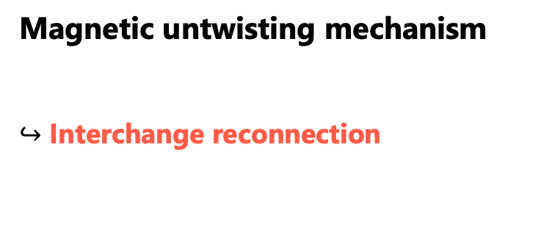
Magnetic untwisting mechanism
Magnetic untwisting mechanism
$↪$ Interchange reconnection
Pariat et al. 2009, 2023 ; Wyper et al. 2018 ; Karpen et al. 2017 ; Uritsky et al. 2017 ; Roberts et al. 2018
Schmieder et al. 1995
PNST Conference - 08/01/2024 J. Touresse 5/12
Notes:
Along with modeling of solar eruptions, modeling of coronal jets has developed since > 35 years

Slide 21
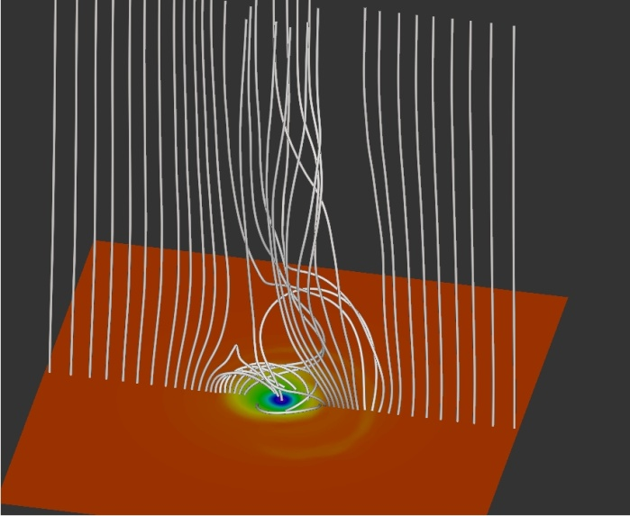
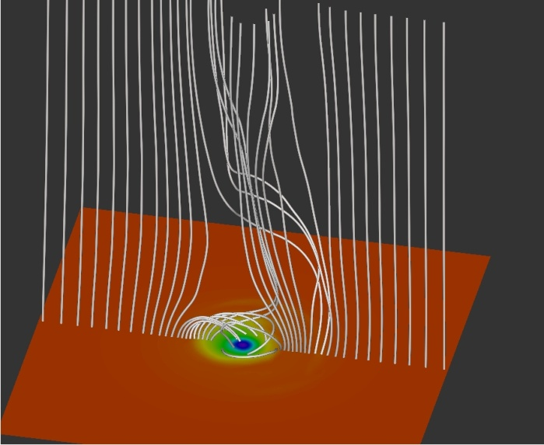
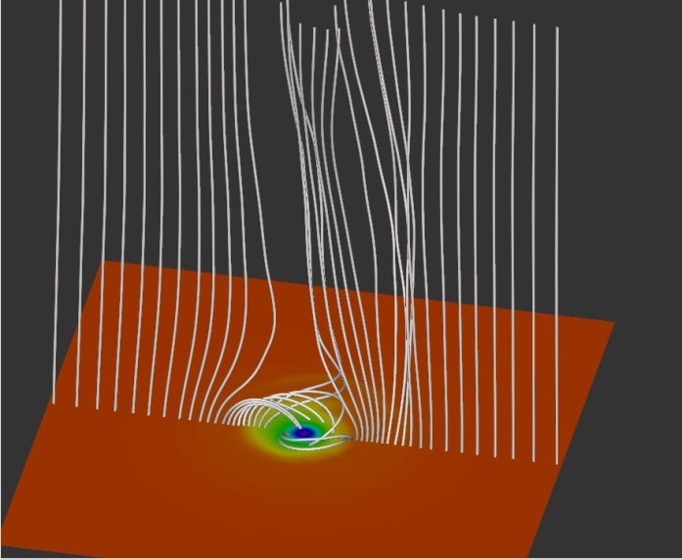
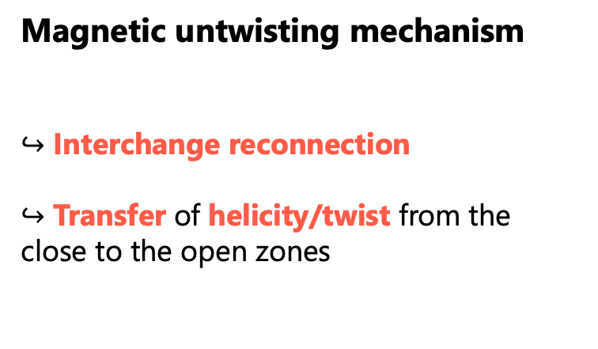
Magnetic untwisting mechanism
Magnetic untwisting mechanism
$↪$ Interchange reconnection
$↪$ Transfer of helicity/twist from the close to the open zones
Pariat et al. 2009, 2023 ; Wyper et al. 2018 ; Karpen et al. 2017 ; Uritsky et al. 2017 ; Roberts et al. 2018
Schmieder et al. 1995
Pariat et al. 2009
PNST Conference - 08/01/2024 J. Touresse 5/12
Notes:
Along with modeling of solar eruptions, modeling of coronal jets has developed since > 35 years

Slide 22
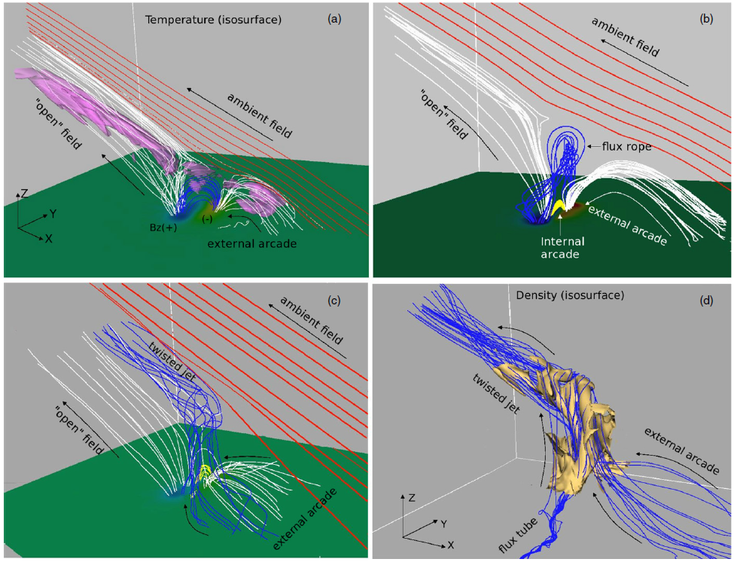
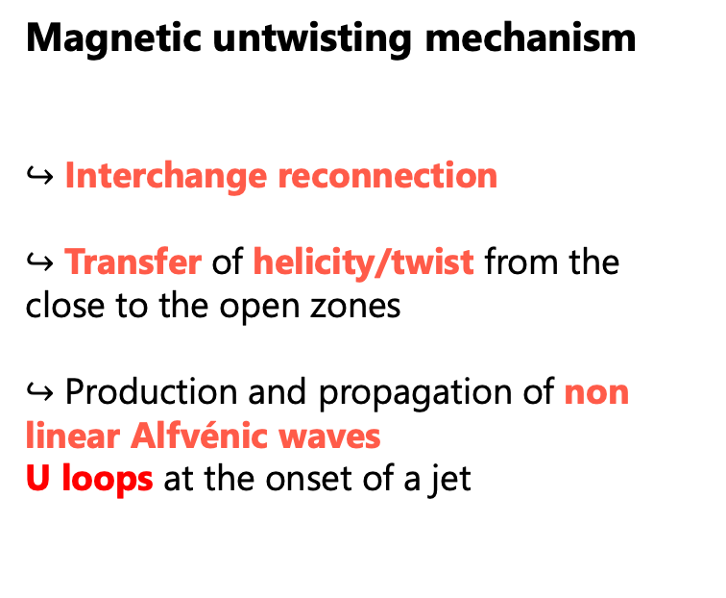
Magnetic untwisting mechanism
Magnetic untwisting mechanism
$↪$ Interchange reconnection
$↪$ Transfer of helicity/twist from the close to the open zones
$↪$ Production and propagation of non linear Alfvénic waves
U loops at the onset of a jet
Pariat et al. 2009, 2023 ; Wyper et al. 2018 ; Karpen et al. 2017 ; Uritsky et al. 2017 ; Roberts et al. 2018
Schmieder et al. 1995
Pariat et al. 2009
Archontis et al. 2013
PNST Conference - 08/01/2024 J. Touresse 5/12
Notes:
Along with modeling of solar eruptions, modeling of coronal jets has developed since > 35 years

Slide 23
Switchbacks: Do switchback have a solar origin?
Two families of scenario:
In situ
Low solar atmosphere
If it is the case, which solar phenomenon can be the progenitor of switchbacks?
How are the switchbacks generated from the low solar atmosphere?
Akhavan-Tafti et al. 2022
Fisk & Kasper et al. 2020
Sterling & Moore 2020
PNST Conference - 08/01/2024 J. Touresse 6/12

Slide 24
Switchbacks: Do switchback have a solar origin?
Two families of scenario:
In situ
Low solar atmosphere
If it is the case, which solar phenomenon can be the progenitor of switchbacks?
Because : - intermittent
- ubiquitous
- propagation of magnetic deflections at high
heights
- U-loop present at the bottom
Jets
How are the switchbacks generated from the low solar atmosphere?
Akhavan-Tafti et al. 2022
Fisk & Kasper et al. 2020
Sterling & Moore 2020
PNST Conference - 08/01/2024 J. Touresse 6/12

Slide 25
Switchbacks: Do switchback have a solar origin?
Two families of scenario:
In situ
Low solar atmosphere
If it is the case, which solar phenomenon can be the progenitor of switchbacks?
Because : - intermittent
- ubiquitous
- propagation of magnetic deflections at high
heights
- U-loop present at the bottom
Jets
How are the switchbacks generated from the low solar atmosphere?
Akhavan-Tafti et al. 2022
What are the low solar mechanisms that induce
switchbacks ?
Is it like the cartoons ? Does the U-loop survive ?
Fisk & Kasper et al. 2020
Sterling & Moore 2020
PNST Conference - 08/01/2024 J. Touresse 6/12

Slide 26
Switchbacks: Do switchback have a solar origin?
Two families of scenario:
In situ
Low solar atmosphere
If it is the case, which solar phenomenon can be the progenitor of switchbacks?
Because : - intermittent
- ubiquitous
- propagation of magnetic deflections at high
heights
- U-loop present at the bottom
Jets
How are the switchbacks generated from the low solar atmosphere?
Akhavan-Tafti et al. 2022
What are the low solar mechanisms that induce
switchbacks ?
Is it like the cartoons ? Does the U-loop survive ?
Method : Simulations of the propagation of solar jets across the heliosphere
Fisk & Kasper et al. 2020
Sterling & Moore 2020
PNST Conference - 08/01/2024 J. Touresse 6/12

Slide 27
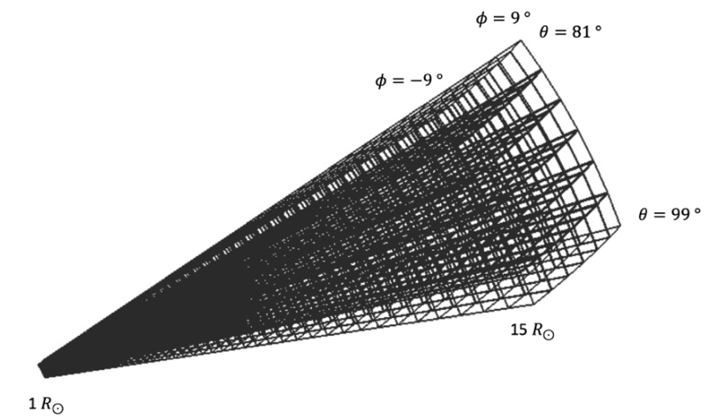
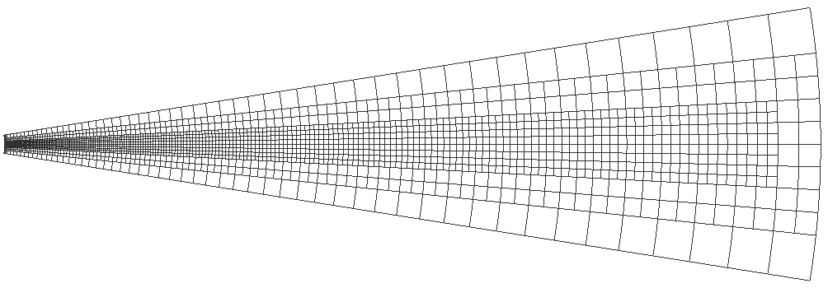

Jet propagation simulation : Numerical Model
ARMS (Adaptively Refined MHD Solver) code:
  3D MHD simulations with Flux Corrected Transport (FCT)
  Unstructured grid and dynamic adaptative mesh
-1.540
0.053
1.645
3.238
4.830
Log ($ρ$)
Grid of the computational domain
2D cut of the grid of the computational domain
PNST Conference - 08/01/2024 J. Touresse 7/12

Slide 28


Jet propagation simulation : Initial Conditions
Initial conditions:
  Parker isothermal solar wind in a stratified atmosphere
$$\frac{v_{r}^{2}}{c_{s}^{2}}\exp\left(1−\frac{v_{r}^{2}}{c_{s}^{2}}\right)=\frac{r_{s}^{4}}{r^{4}}\exp\left(4−4\frac{r_{s}}{r}\right)$$
-1.540
0.053
1.645
3.238
4.830
-1.540
0.053
1.645
3.238
Log ($ρ$)
4.830
Log ($ρ$)
2D cut of the logarithm of the mass density in the low beta simulation Touresse et al. (in preparation)
PNST Conference - 08/01/2024 J. Touresse 8/12

Slide 29

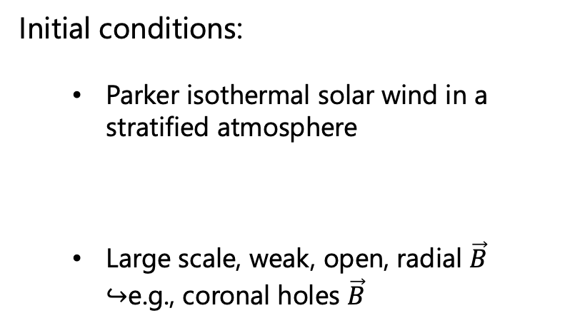


Jet propagation simulation : Initial Conditions
Initial conditions:
  Parker isothermal solar wind in a stratified atmosphere
  Large scale, weak, open, radial $\vec{B}$ $↪$e.g., coronal holes $\vec{B}$
$$\frac{v_{r}^{2}}{c_{s}^{2}}\exp\left(1−\frac{v_{r}^{2}}{c_{s}^{2}}\right)=\frac{r_{s}^{4}}{r^{4}}\exp\left(4−4\frac{r_{s}}{r}\right)$$
-1.540
0.053
1.645
3.238
4.830
-1.540
0.053
1.645
3.238
Log ($ρ$)
4.830
Log ($ρ$)
2D cut of the logarithm of the mass density in the low beta simulation Touresse et al. (in preparation)
-2.250
-1.688
-1.125
0.563
0.00
Log ($B$)
2D cut of the logarithm of the magnitude of the magnetic field in the low beta simulation Touresse et al. (in preparation)
PNST Conference - 08/01/2024 J. Touresse 8/12

Slide 30
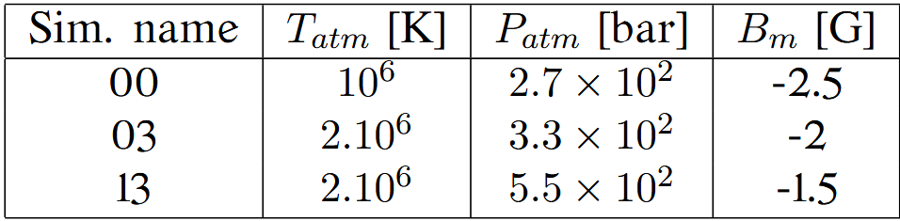



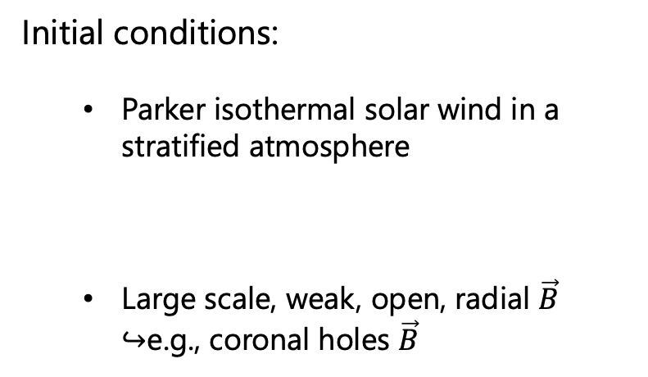
Jet propagation simulation : Initial Conditions
Initial conditions:
  Parker isothermal solar wind in a stratified atmosphere
  Large scale, weak, open, radial $\vec{B}$ $↪$e.g., coronal holes $\vec{B}$
$$\frac{v_{r}^{2}}{c_{s}^{2}}\exp\left(1−\frac{v_{r}^{2}}{c_{s}^{2}}\right)=\frac{r_{s}^{4}}{r^{4}}\exp\left(4−4\frac{r_{s}}{r}\right)$$
-1.540
0.053
1.645
3.238
4.830
-1.540
0.053
1.645
3.238
Log ($ρ$)
4.830
Log ($ρ$)
2D cut of the logarithm of the mass density in the low beta simulation Touresse et al. (in preparation)
Low $β$
Medium $β$
High $β$
-2.250
-1.688
-1.125
0.563
0.00
Log ($B$)
2D cut of the logarithm of the magnitude of the magnetic field in the low beta simulation Touresse et al. (in preparation)
PNST Conference - 08/01/2024 J. Touresse 8/12

Slide 31
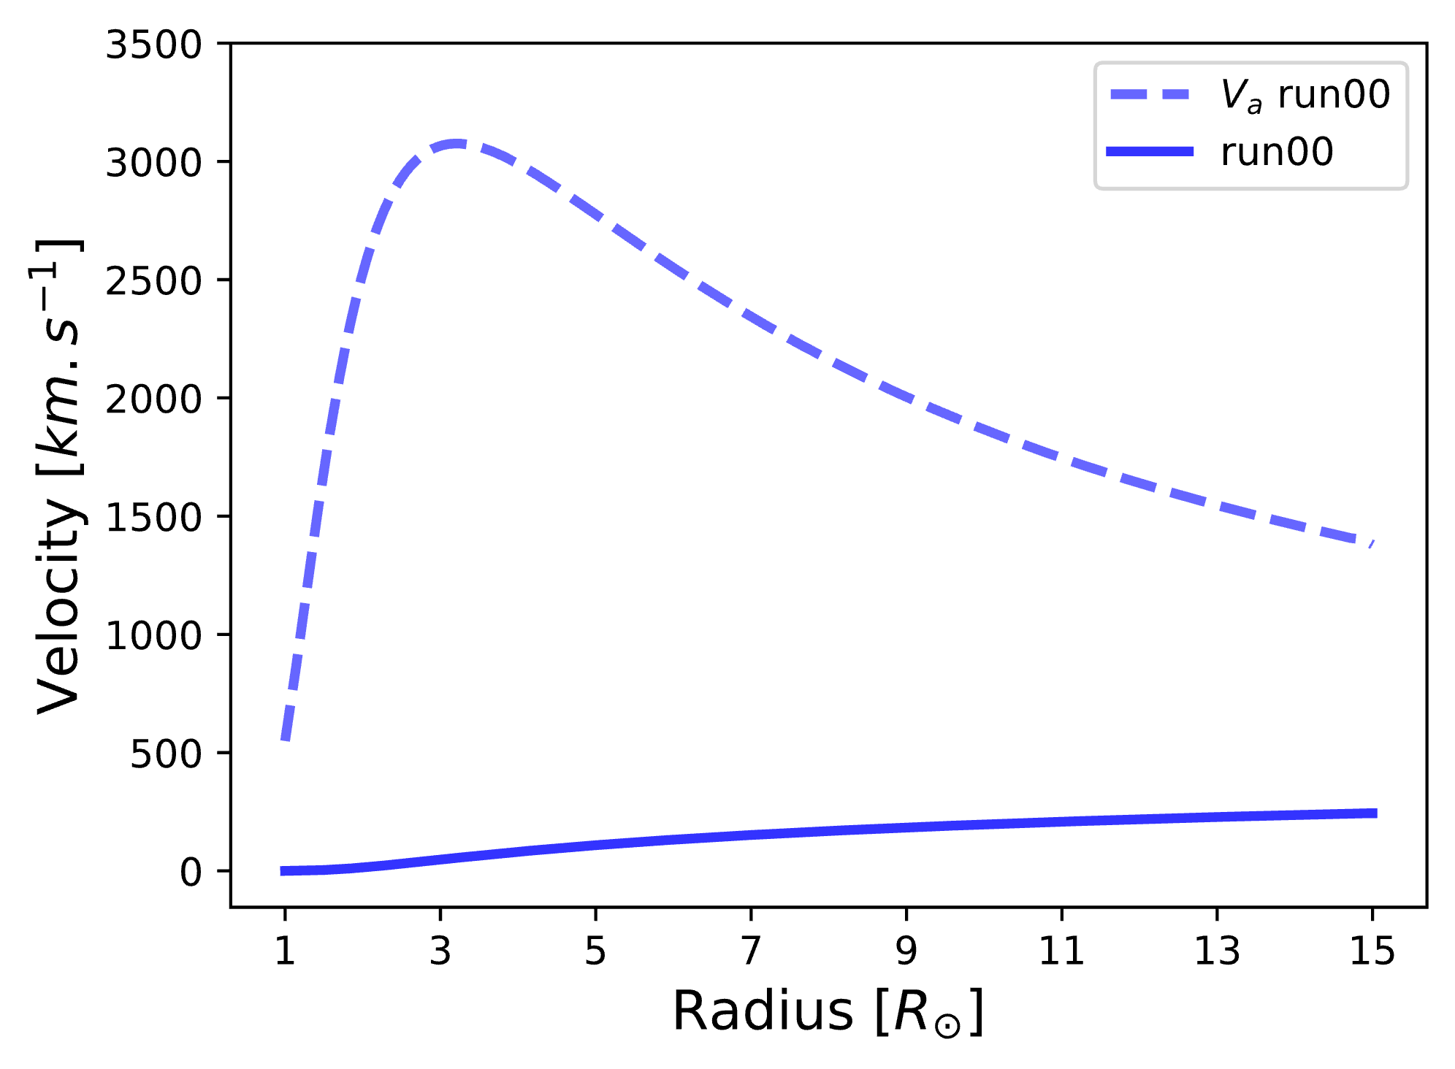
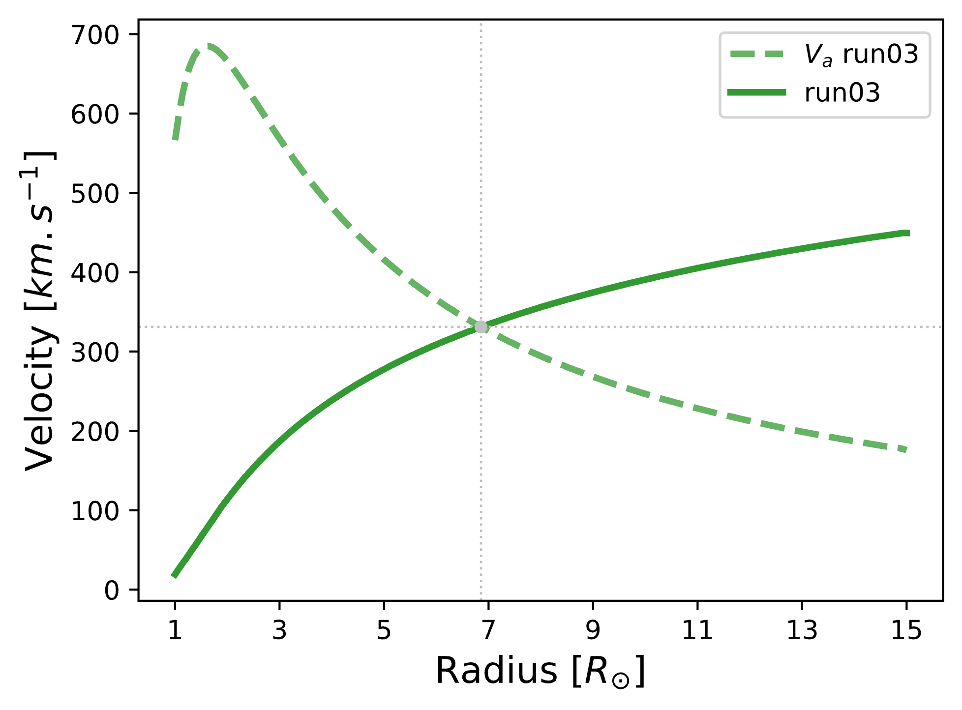
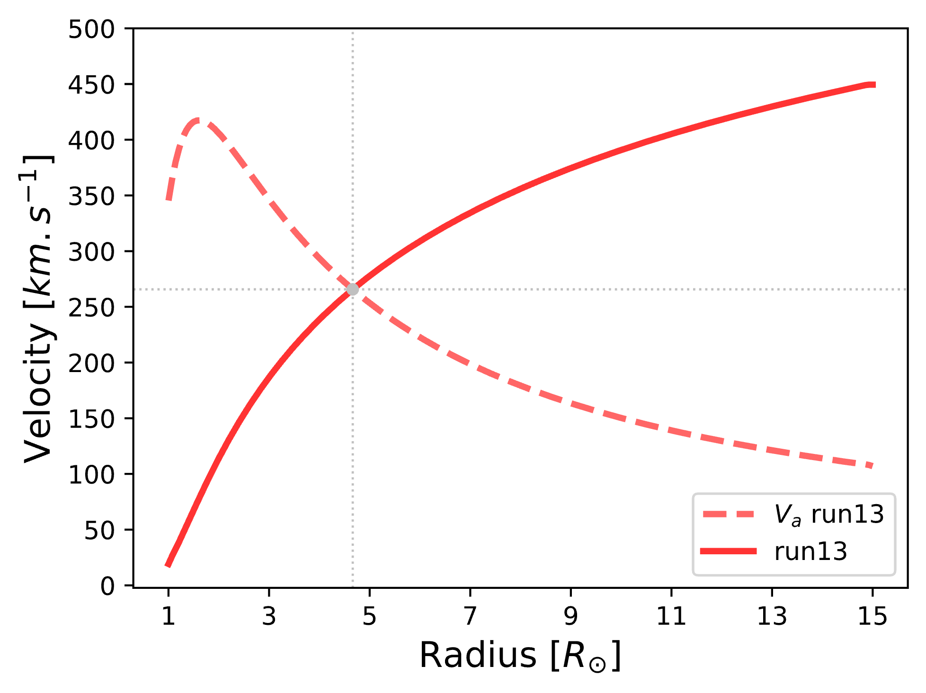
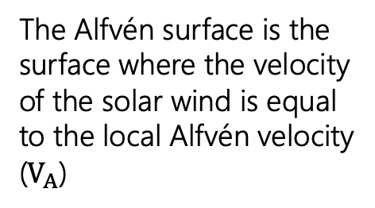



Jet propagation simulation : Initial Conditions
Low Beta Simulation
Initial conditions:
  Parker isothermal solar wind in a stratified atmosphere
  Large scale, weak, open, radial $\vec{B}$ $↪$e.g., coronal holes $\vec{B}$
$$V_{A}$$
The Alfvén surface is the surface where the velocity of the solar wind is equal to the local Alfvén velocity ($V_{A}$)
V
Sub
Alfvénic
wind
$$\frac{v_{r}^{2}}{c_{s}^{2}}\exp\left(1−\frac{v_{r}^{2}}{c_{s}^{2}}\right)=\frac{r_{s}^{4}}{r^{4}}\exp\left(4−4\frac{r_{s}}{r}\right)$$
-1.540
-1.688
-1.125
0.563
0.00
0.053
1.645
3.238
4.830
Log ($ρ$)
Log ($B$)
Medium Beta Simulation
High Beta Simulation
$$V_{A}$$
Super
Alfvénic
wind
V
Low $β$
Sub
Alfvénic
wind
Sub
Alfvénic
wind
Super
Alfvénic
wind
Medium $β$
High $β$
$$V_{A}$$
V
PNST Conference - 08/01/2024 J. Touresse 8/12

Slide 32
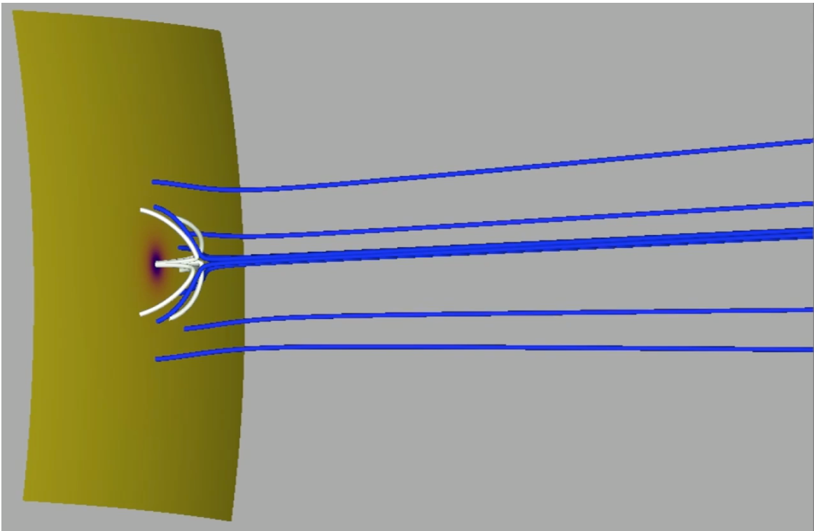
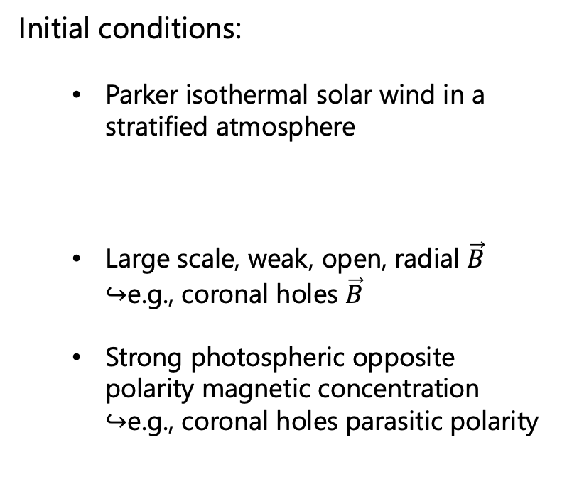

Jet propagation simulation : Initial Conditions
Initial conditions:
  Parker isothermal solar wind in a stratified atmosphere
  Large scale, weak, open, radial $\vec{B}$ $↪$e.g., coronal holes $\vec{B}$
  Strong photospheric opposite polarity magnetic concentration $↪$e.g., coronal holes parasitic polarity
$$\frac{v_{r}^{2}}{c_{s}^{2}}\exp\left(1−\frac{v_{r}^{2}}{c_{s}^{2}}\right)=\frac{r_{s}^{4}}{r^{4}}\exp\left(4−4\frac{r_{s}}{r}\right)$$
-1.540
-1.688
-1.125
0.563
0.00
0.053
1.645
3.238
4.830
Log ($ρ$)
Log ($B$)
Zoom on the initial magnetic configuration Touresse et al. (in preparation)
PNST Conference - 08/01/2024 J. Touresse 8/12

Slide 33
Jet propagation simulation : Steps
  Relaxation
-1.540
-1.688
-1.125
0.563
0.00
0.053
1.645
3.238
4.830
Log ($ρ$)
Log ($B$)
Zoom close to the solar surface during the relaxation Touresse et al. (in preparation)
PNST Conference - 08/01/2024 J. Touresse 9/12

Slide 34
Jet propagation simulation : Steps
  Relaxation
  Injection of the twist
-1.540
Zoom close to the solar surface during the injection of the twist Touresse et al. (in preparation)
PNST Conference - 08/01/2024 J. Touresse 9/12

Slide 35
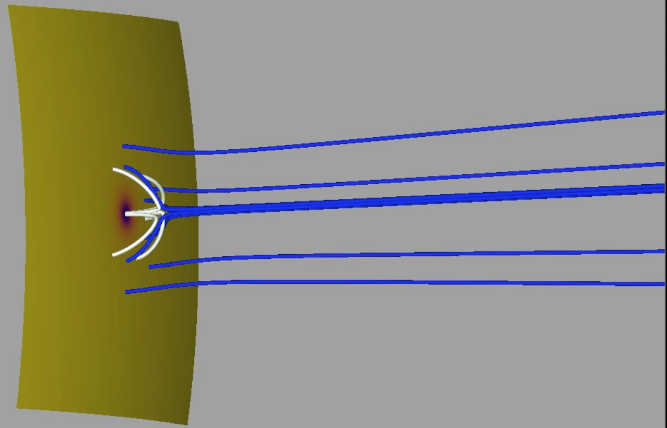
Jet propagation simulation : Steps
  Relaxation
  Injection of the twist
-1.540
-1.688
-1.125
0.563
0.00
0.053
1.645
3.238
4.830
Log ($ρ$)
Log ($B$)
Zoom close to the solar surface during the injection of the twist Touresse et al. (in preparation)
PNST Conference - 08/01/2024 J. Touresse 9/12

Slide 36

Jet propagation simulation : Steps
  Relaxation
  Injection of the twist
  Magnetic reconnection
-1.540
-1.688
-1.125
0.563
0.00
0.053
1.645
3.238
4.830
Log ($ρ$)
Log ($B$)
Zoom close to the solar surface during the magnetic reconnection Touresse et al. (in preparation)
$⟹$ no U-loop above 0.1 $R_{⊙}$
Schmieder et al. 1995
PNST Conference - 08/01/2024 J. Touresse 9/12

Slide 37
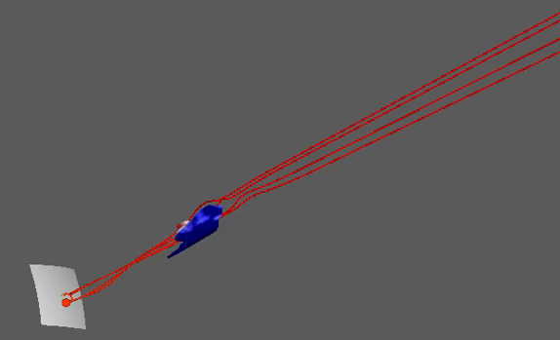


Jet propagation simulation : Steps
magnetic fieldlines $:−$
$v_{t}$ : $⟶$
$⟵$
  Relaxation
  Injection of the twist
  Magnetic reconnection
  Jet Propagation
-1.540
-1.688
-1.125
0.563
0.00
0.053
1.645
3.238
4.830
Log ($ρ$)
Log ($B$)
3D jet propagation in the high beta simulation Touresse et al. (in preparation)
PNST Conference - 08/01/2024 J. Touresse 9/12

Slide 38

Magnetic deflections
Creation of synthetic data to compare with in situ observations
0
125
250
375
500
Velocity Magnitude($km.s^{−1}$)
PNST Conference - 08/01/2024 J. Touresse 10/12

Slide 39
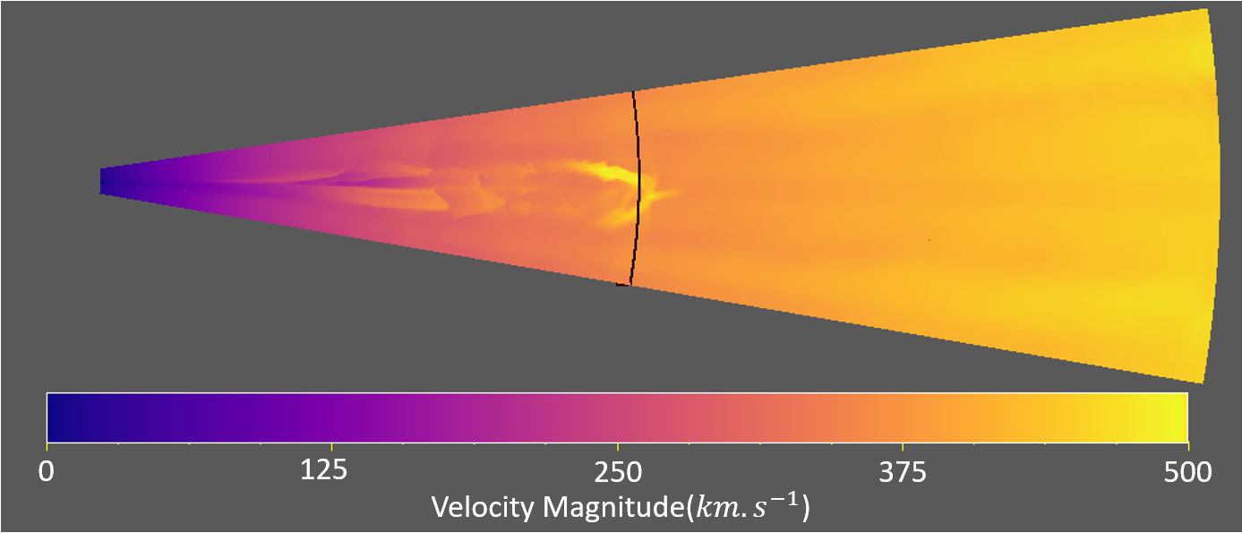
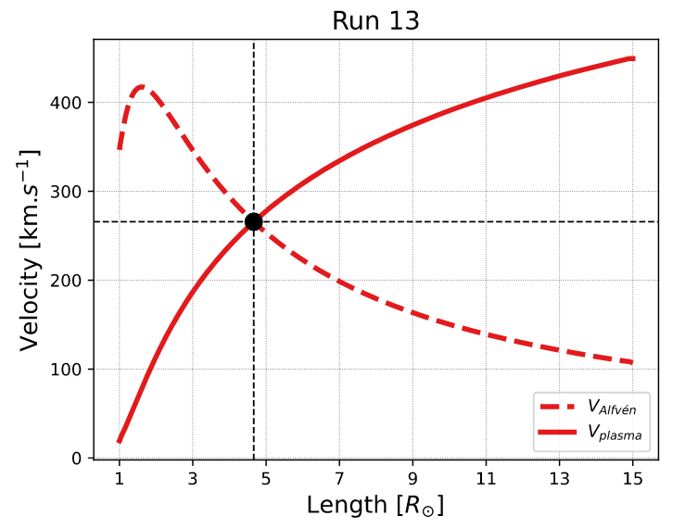

Magnetic deflections
Creation of synthetic data to compare with in situ observations
High Beta simulation – 75100s – R = $7.73 R_{⨀}$
0
125
250
375
500
Velocity Magnitude($km.s^{−1}$)
Sub
Alfvénic
wind
Super
Alfvénic
wind
Touresse et al. (in prep.)
PNST Conference - 08/01/2024 J. Touresse 10/12

Slide 40
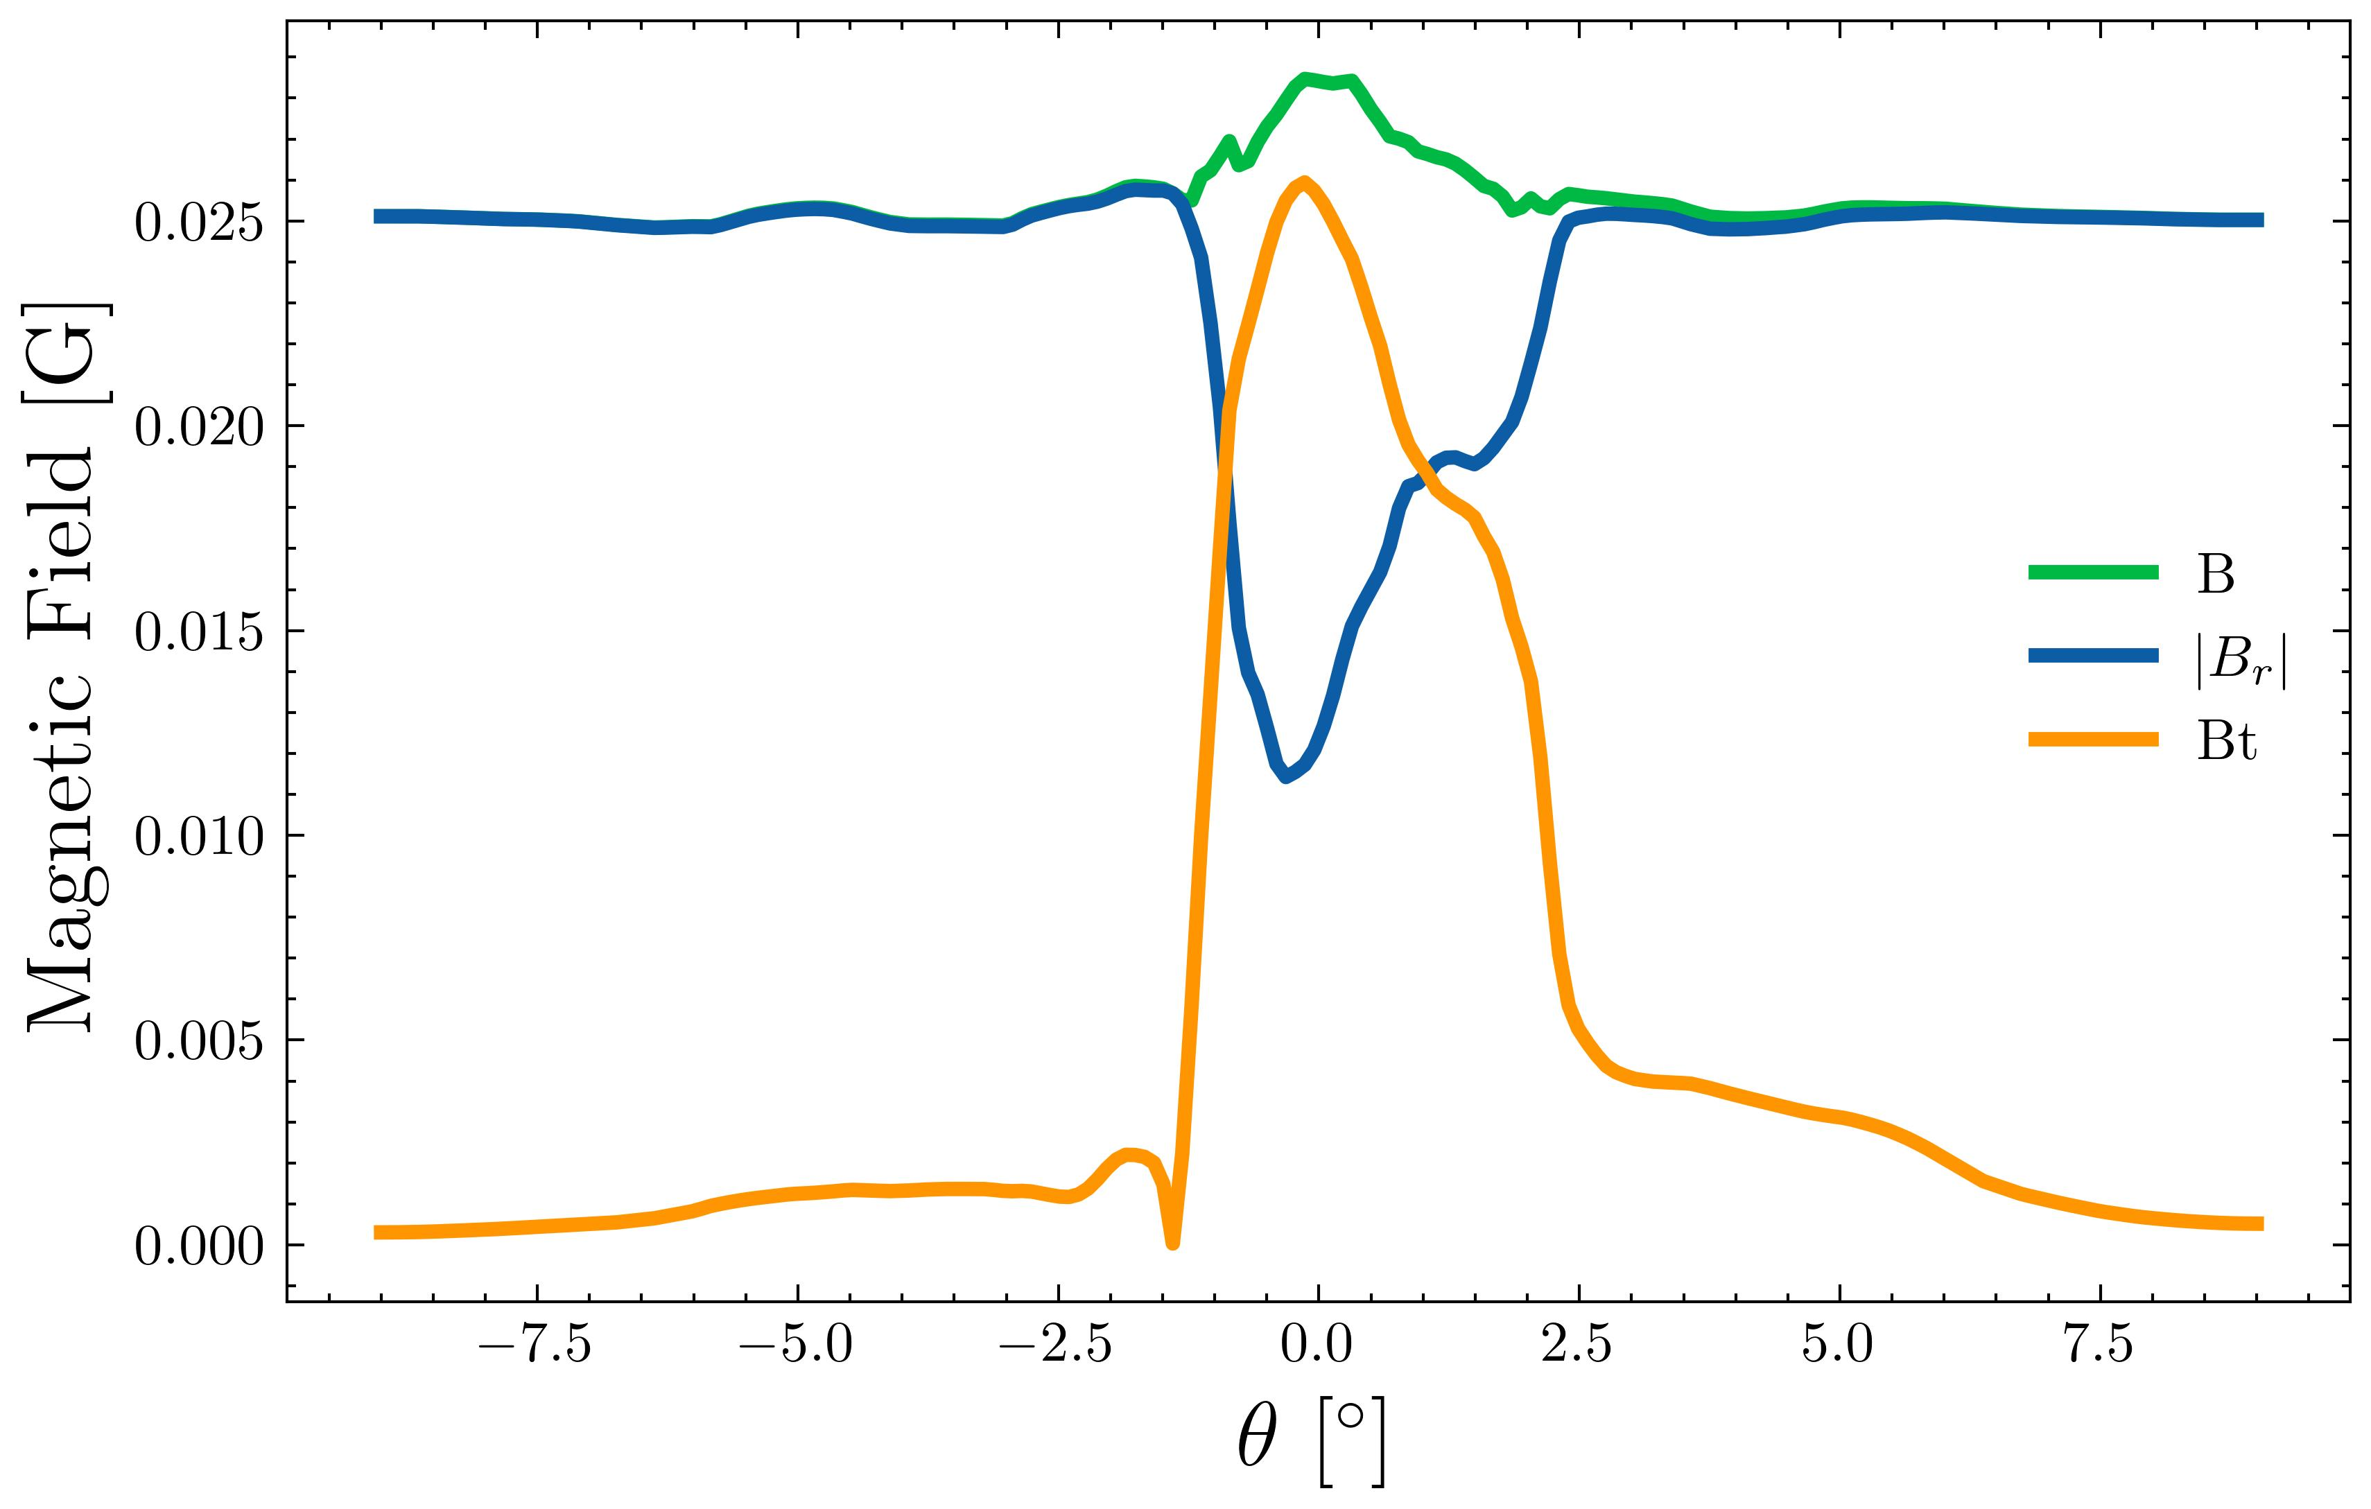
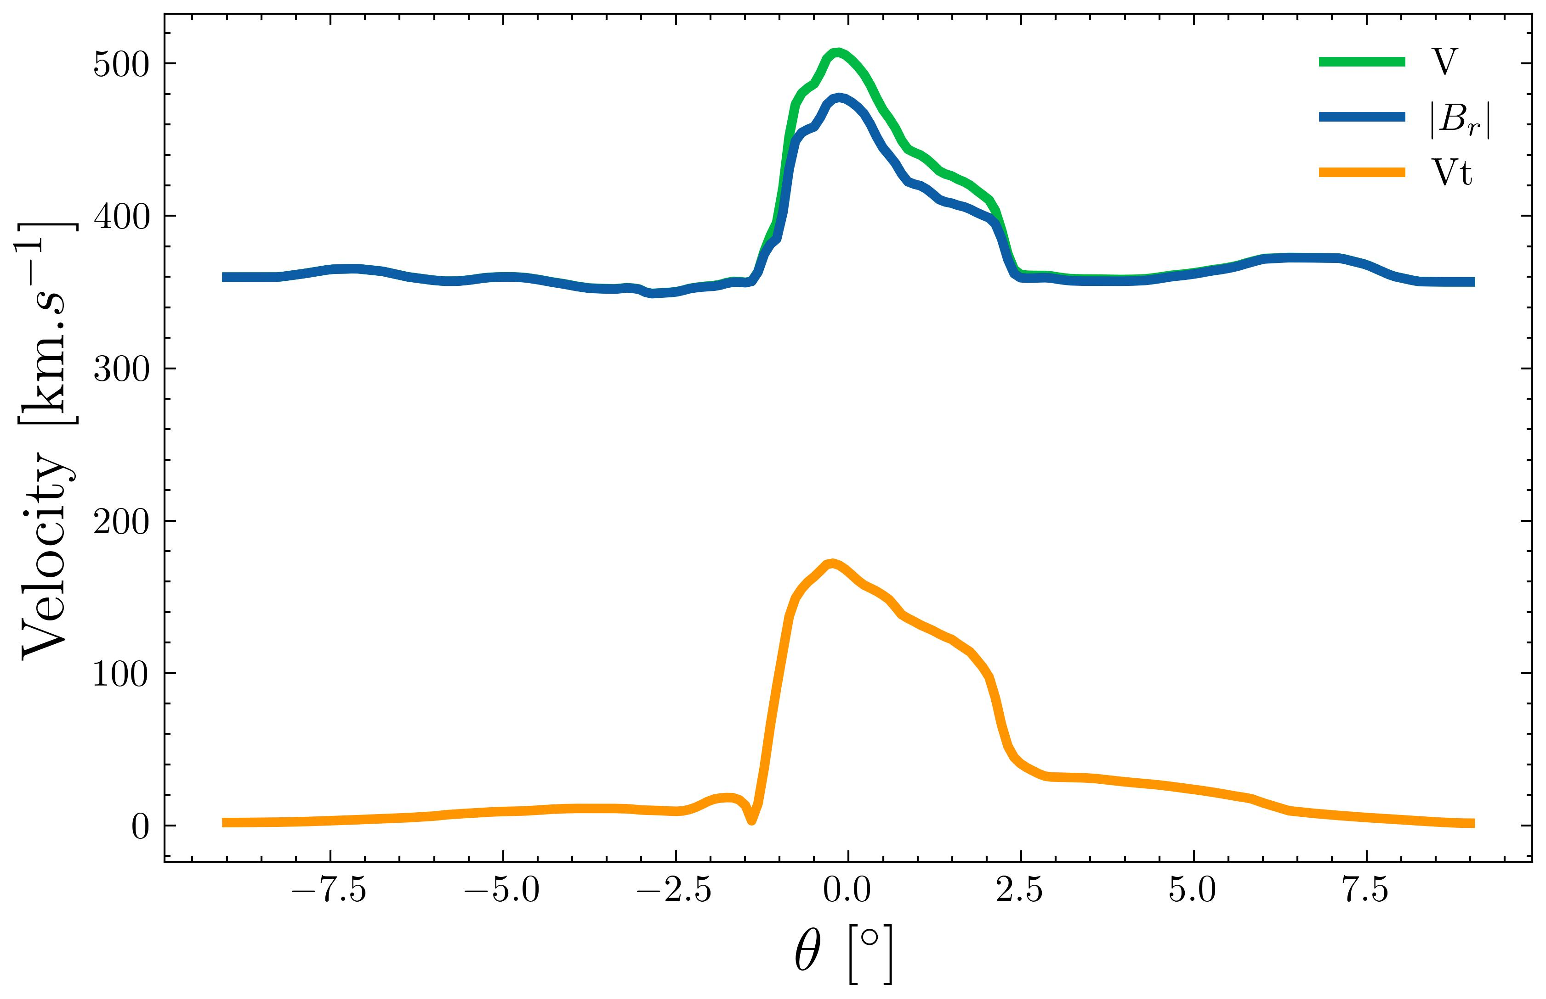
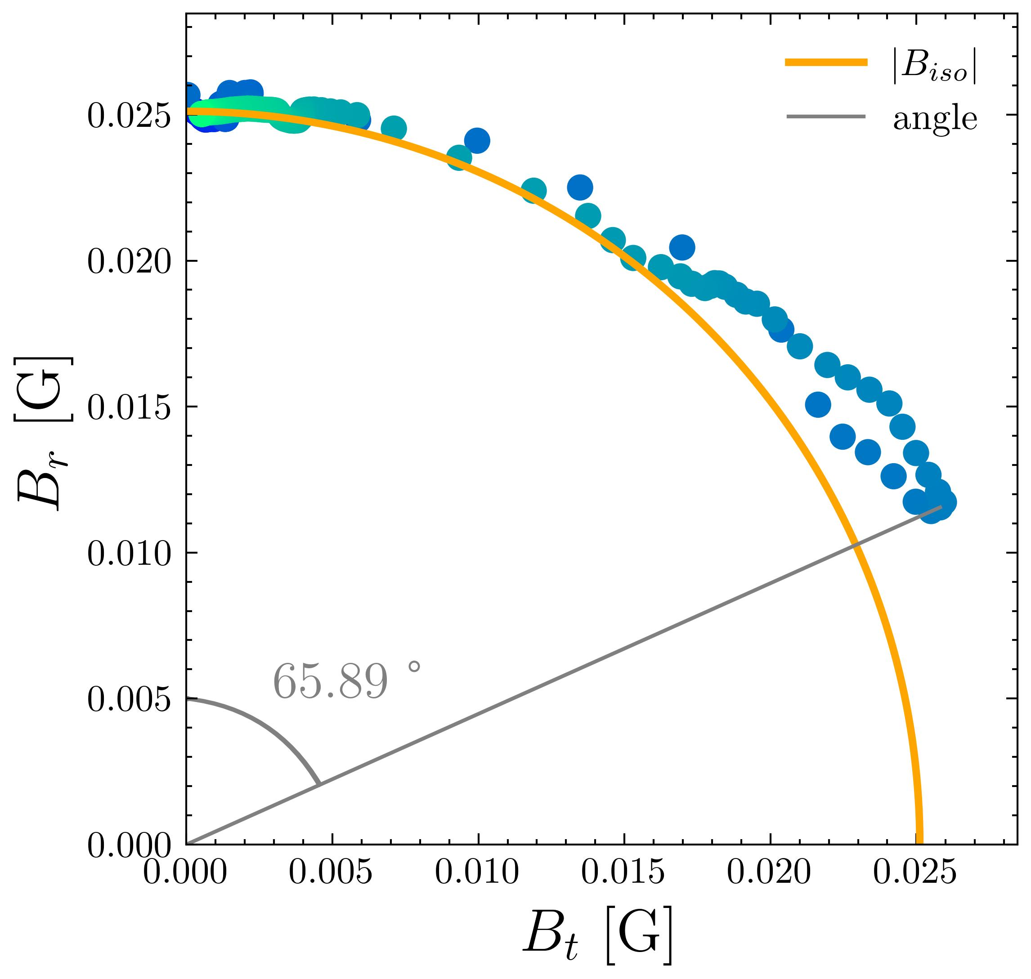











Magnetic deflections
Synthetic Magnetic Field Measurement
Creation of synthetic data to compare with in situ observations
$$B$$
Magnetic Field [G]
$$\left|B_{r}\right|$$
$$B_{t}$$
$$θ [°]$$
Synthetic Velocity Measurement
High Beta simulation – 75100s – R = $7.73 R_{⨀}$
$$V$$
Velocity [$km.s^{−1}$]
$$V_{r}$$
Sub
Alfvénic
wind
Super
Alfvénic
wind
$$B_{r} [G]$$
$$V_{t}$$
65, 89°
$$θ [°]$$
Touresse et al. (in prep.)
$$B_{t} [G]$$
PNST Conference - 08/01/2024 J. Touresse 10/12

Slide 41
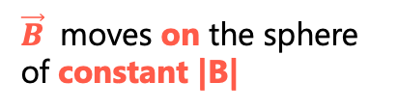


Magnetic deflections
Synthetic Magnetic Field Measurement
Definition: Switchbacks are ubiquitous, intermittent, Alfvénic magnetic deflections [1,2,3].
Properties:
An increase in $v_{r}$, e.g. microstream
A deflection in $B_{r}$
|B| roughly constant (max 15 %)
$$B$$
Magnetic Field [G]
$$\left|B_{r}\right|$$
$\vec{B}$ moves on the sphere of constant |B|
$$B_{t}$$
$$θ [°]$$
Synthetic Velocity Measurement
Velocity [$km.s^{−1}$]
$$V$$
$$V_{r}$$
$$B_{r} [G]$$
$$V_{t}$$
65, 89°
$$θ [°]$$
$$B_{t} [G]$$
Touresse et al. (in prep.)
PNST Conference - 08/01/2024 J. Touresse 10/12

Slide 42
Magnetic deflections
Synthetic Magnetic Field Measurement
Definition: Switchbacks are ubiquitous, intermittent, Alfvénic magnetic deflections [1,2,3].
Properties:
An increase in $v_{r}$, e.g. microstream
A deflection in $B_{r}$
|B| roughly constant (max 15 %)
$$B$$
Magnetic Field [G]
$$\left|B_{r}\right|$$
$\vec{B}$ moves on the sphere of constant |B|
$$B_{t}$$
$$θ [°]$$
Synthetic Velocity Measurement
Velocity [$km.s^{−1}$]
$$V$$
$$V_{r}$$
$$B_{r} [G]$$
$$V_{t}$$
65, 89°
$$θ [°]$$
$$B_{t} [G]$$
Touresse et al. (in prep.)
PNST Conference - 08/01/2024 J. Touresse 10/12

Slide 43
Magnetic deflections
Synthetic Magnetic Field Measurement
Definition: Switchbacks are ubiquitous, intermittent, Alfvénic magnetic deflections [1,2,3].
Properties:
An increase in $v_{r}$, e.g. microstream
A deflection in $B_{r}$
|B| roughly constant (max 15 %)
$$B$$
Magnetic Field [G]
$$\left|B_{r}\right|$$
$\vec{B}$ moves on the sphere of constant |B|
$$B_{t}$$
$$θ [°]$$
Synthetic Velocity Measurement
Velocity [$km.s^{−1}$]
$$V$$
$$V_{r}$$
$$B_{r} [G]$$
$$V_{t}$$
65, 89°
$$θ [°]$$
$$B_{t} [G]$$
Touresse et al. (in prep.)
PNST Conference - 08/01/2024 J. Touresse 10/12

Slide 44
Magnetic deflections
Synthetic Magnetic Field Measurement
Definition: Switchbacks are ubiquitous, intermittent, Alfvénic magnetic deflections [1,2,3].
Properties:
An increase in $v_{r}$, e.g. microstream
A deflection in $B_{r}$
|B| roughly constant (max 15 %)
$$B$$
Magnetic Field [G]
$$\left|B_{r}\right|$$
$\vec{B}$ moves on the sphere of constant |B|
$$B_{t}$$
$$θ [°]$$
Synthetic Velocity Measurement
Velocity [$km.s^{−1}$]
$$V$$
$$V_{r}$$
$$B_{r} [G]$$
$$V_{t}$$
65, 89°
$$θ [°]$$
$$B_{t} [G]$$
Touresse et al. (in prep.)
PNST Conference - 08/01/2024 J. Touresse 10/12

Slide 45

Magnetic deflections
Synthetic Magnetic Field Measurement
Definition: Switchbacks are ubiquitous, intermittent, Alfvénic magnetic deflections [1,2,3].
Properties:
An increase in $v_{r}$, e.g. microstream
A deflection in $B_{r}$
|B| roughly constant (max 15 %)
$$B$$
Magnetic Field [G]
$$\left|B_{r}\right|$$
$\vec{B}$ moves on the sphere of constant |B|
$$B_{t}$$
$$θ [°]$$
Synthetic Velocity Measurement
Observational data
Synthetic data
$$V$$
Velocity [$km.s^{−1}$]
$$V_{r}$$
$$B_{T′} [nT]$$
$$B_{r} [G]$$
$$V_{t}$$
65, 89°
$$θ [°]$$
$$B_{R′} [nT]$$
Drake et al. 2021
$⇒$No full reversal switchbacks
$$B_{t} [G]$$
Touresse et al. (in prep.)
PNST Conference - 08/01/2024 J. Touresse 10/12

Slide 46
Switchbacks: Do switchback have a solar origin?
Two families of scenario:
In situ
Low solar atmosphere
If it is the case, which solar phenomenon can be the progenitor of switchbacks?
Because : - intermittent
- ubiquitous
- propagation of magnetic deflections at high
heights
- U-loop present at the bottom
Jets
How are the switchbacks generated from the low solar atmosphere?
Akhavan-Tafti et al. 2022
What are the low solar mechanisms that induce
switchbacks ?
Is it like the cartoons ? Does the U-loop survive ?
Fisk & Kasper et al. 2020
Sterling & Moore 2020
PNST Conference - 08/01/2024 J. Touresse 11/12

Slide 47

Switchbacks: Do switchback have a solar origin?
Two families of scenario:
In situ
Low solar atmosphere
If it is the case, which solar phenomenon can be the progenitor of switchbacks?
Because : - intermittent
- ubiquitous
- propagation of magnetic deflections at high
heights
- U-loop present at the bottom
Jets
How are the switchbacks generated from the low solar atmosphere?
Akhavan-Tafti et al. 2022
What are the low solar mechanisms that induce
switchbacks ?
Is it like the cartoons ? Does the U-loop survive ?
$↪$ U-loops are not present above 0.1 $R_{⊙}, t$here is no direct injection
Fisk & Kasper et al. 2020
Sterling & Moore 2020
PNST Conference - 08/01/2024 J. Touresse 11/12

Slide 48
Switchbacks: Do switchback have a solar origin?
Two families of scenario:
In situ
Low solar atmosphere
If it is the case, which solar phenomenon can be the progenitor of switchbacks?
Because : - intermittent
- ubiquitous
- propagation of magnetic deflections at high
heights
- U-loop present at the bottom
Jets
How are the switchbacks generated from the low solar atmosphere?
Akhavan-Tafti et al. 2022
What are the low solar mechanisms that induce
switchbacks ?
Is it like the cartoons ? Does the U-loop survive ?
$↪$ U-loops are not present above 0.1 $R_{⊙}, t$here is no direct injection
Fisk & Kasper et al. 2020
Sterling & Moore 2020
PNST Conference - 08/01/2024 J. Touresse 11/12

Slide 49
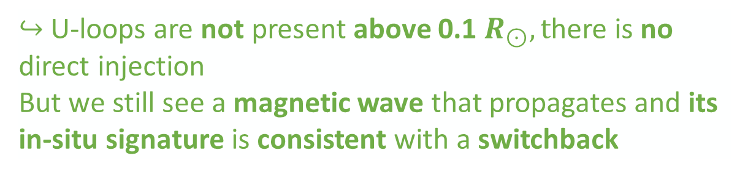
Switchbacks: Do switchback have a solar origin?
Two families of scenario:
In situ
Low solar atmosphere
If it is the case, which solar phenomenon can be the progenitor of switchbacks?
Because : - intermittent
- ubiquitous
- propagation of magnetic deflections at high
heights
- U-loop present at the bottom
Jets
How are the switchbacks generated from the low solar atmosphere?
Akhavan-Tafti et al. 2022
What are the low solar mechanisms that induce
switchbacks ?
Is it like the cartoons ? Does the U-loop survive ?
$↪$ U-loops are not present above 0.1 $R_{⊙}, t$here is no direct injection
But we still see a magnetic wave that propagates and its in-situ signature is consistent with a switchback
Fisk & Kasper et al. 2020
Sterling & Moore 2020
PNST Conference - 08/01/2024 J. Touresse 11/12

Slide 50


Conclusion
Study of the propagation of solar jets towards the heliosphere
U-loops do not survive the low beta corona :
direct injection mechanism
Magnetic untwisting mechanism naturally induces switchbacks (SB) signature
$$B_{r} [G]$$
65, 89°
$$B_{t} [G]$$
However, no full reversal SBs
But it could be the seed for secondary in situ processes
Squire et al. 2022, Toth et al. 2023
3D jet propagation in the high beta simulation Touresse et al. (in prep.)
PNST Conference - 08/01/2024 J. Touresse 12/12

Slide 51
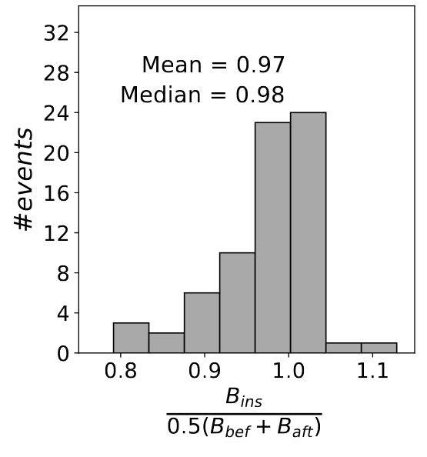
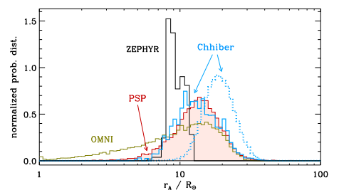
Additional features
Cranmer et al. 23
Statistical properties of the magnetic field magnitude Larosa et al. 21
PNST Conference - 08/01/2024 J. Touresse A

Slide 52
