Slide 1
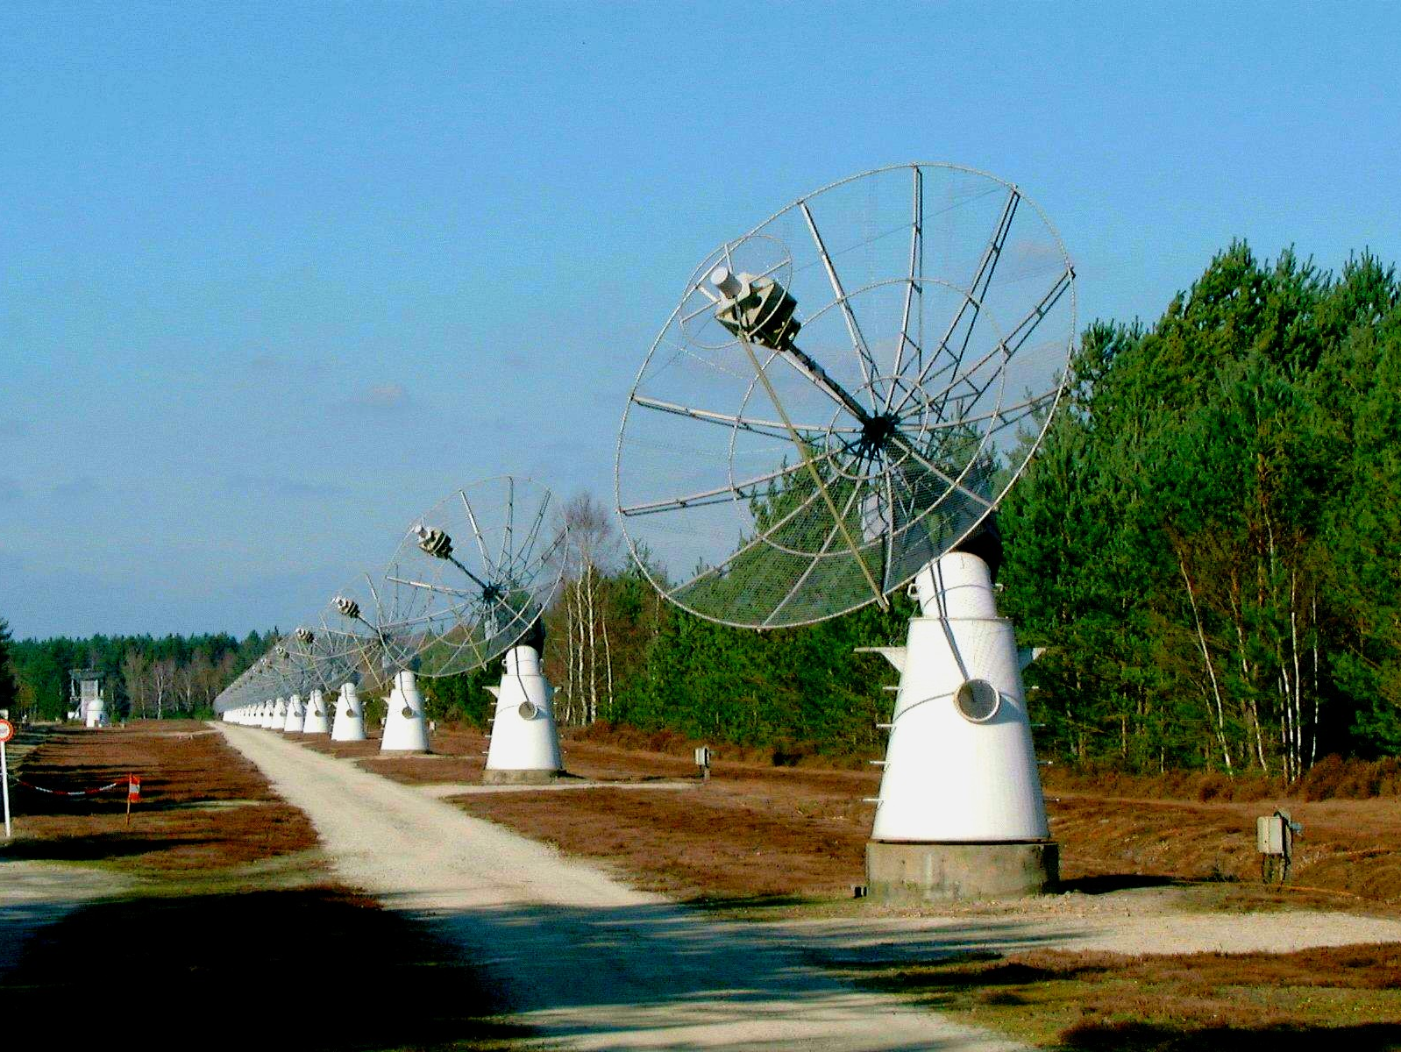








Spectrographic imaging of solar radio bursts
with the Nançay Radioheliograph
and the ORFEES spectrograph
Karl-Ludwig Klein, Abdallah Hamini, Christian Fabrice,
Gabriel Auxepaules, Sophie Masson
ludwig.klein@obspm.fr
Collaborations: Melissa Pesce Rollins (INAF Pisa),
Carolina Salas Matamoros (University of Costa Rica)

Slide 2
Solar Orbiter Science Question
How do solar eruptions produce energetic particle radiation that fills the heliosphere?
What happens in the middle corona – acceleration, confinement, escape?
Müller et al. 20220 AA
- cf. David Paipa’s talk yesterday

Slide 3
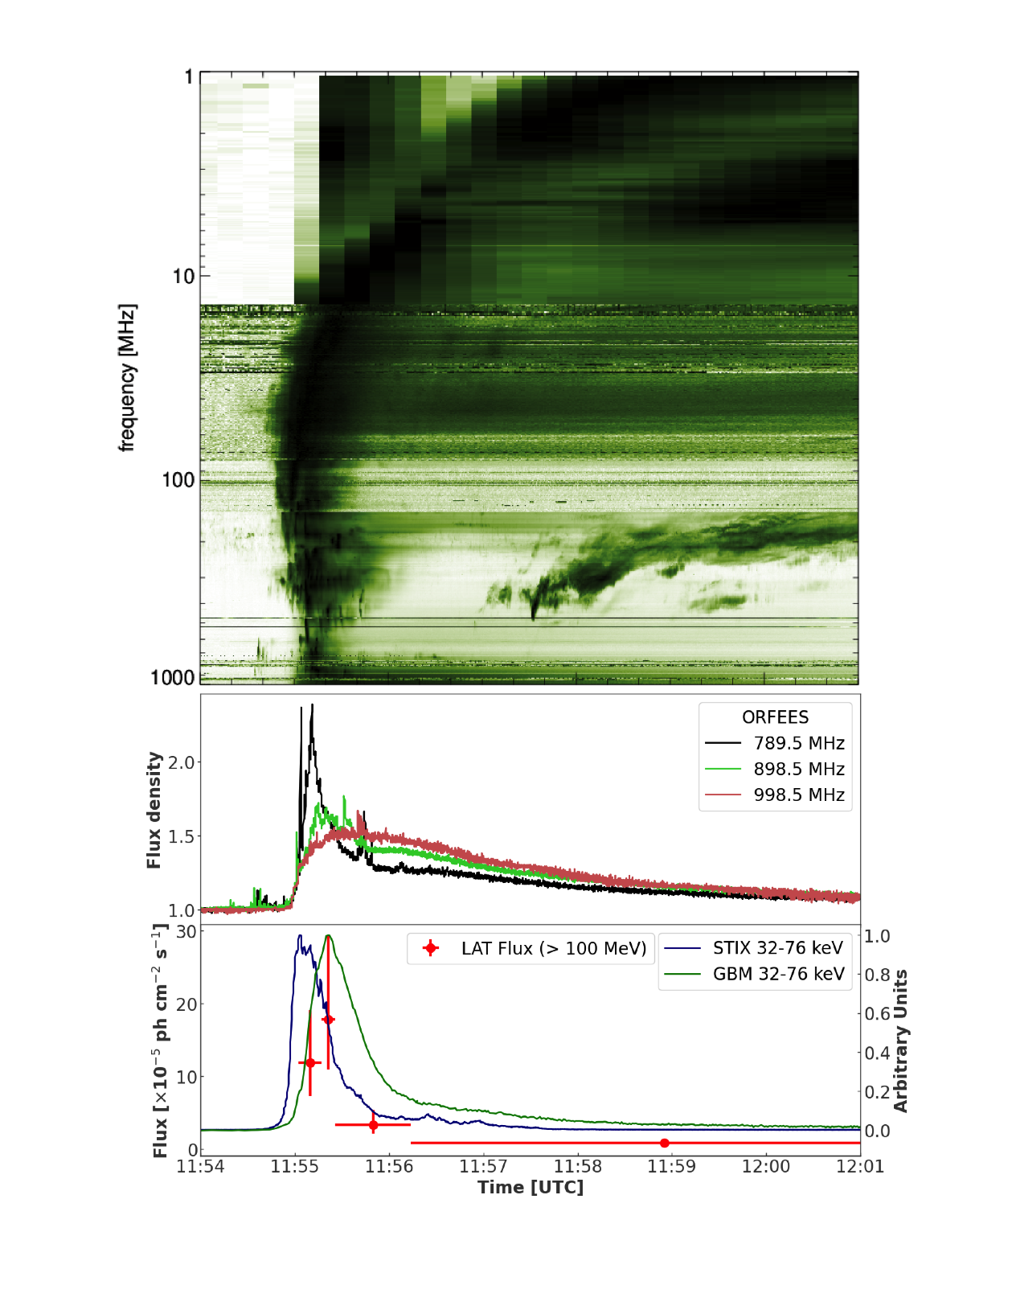
Electron acceleration and propagation
Radio bursts and NT electron populations
artefact
electrons travelling outwards through the corona (r > 2 R)
shock
e beam
coronal shock wave (r ≈ 1.5 R)
trapped e
non-thermal electrons confined in coronal magnetic fields (r < 1.5 R)
“Plasma emission”: radio waves converted from Langmuir waves, ν=ν_{pe} or 2 ν_{pe}~ √ n_{e}
II
Freequency
Density
IV
III
Time

Slide 4
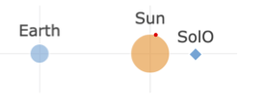
Electron acceleration and propagation
Magnetic connection in the corona
artefact
How can it be that we see γ-rays from behind the solar limb?
flare
Pesce Rollins et al. 2023, Astron. Astrophys., submitted
Radio
HXR & γR (Fermi, STIX; NT electrons -> chromosphere)

Slide 5
Electron acceleration and propagation
Magnetic connection in the corona
artefact
Pesce Rollins et al. 2023, Astron. Astrophys., submitted
Time-differenced dynamic spectrum: band-limited bursts (closed magnetic structures) with different senses of drift (upward/downward moving e-beams)

Slide 6
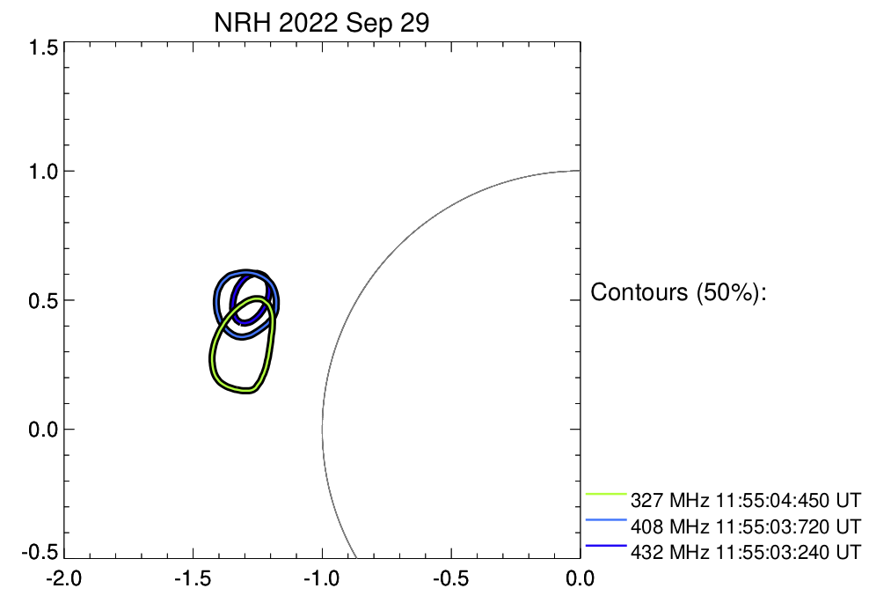
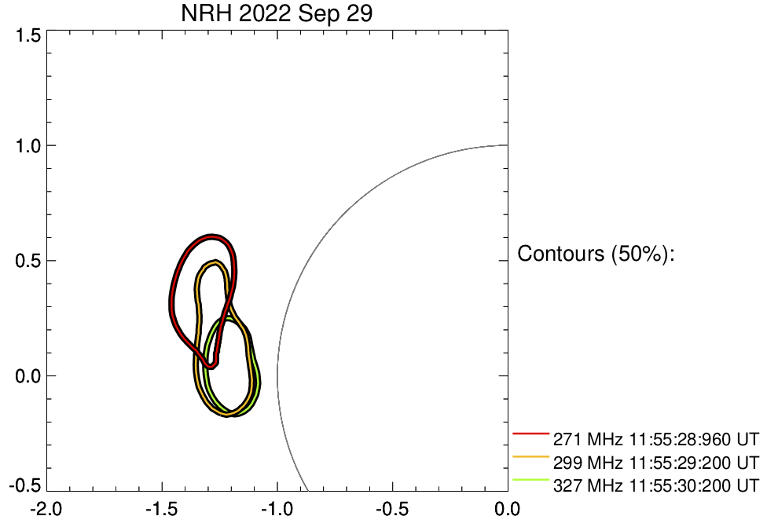
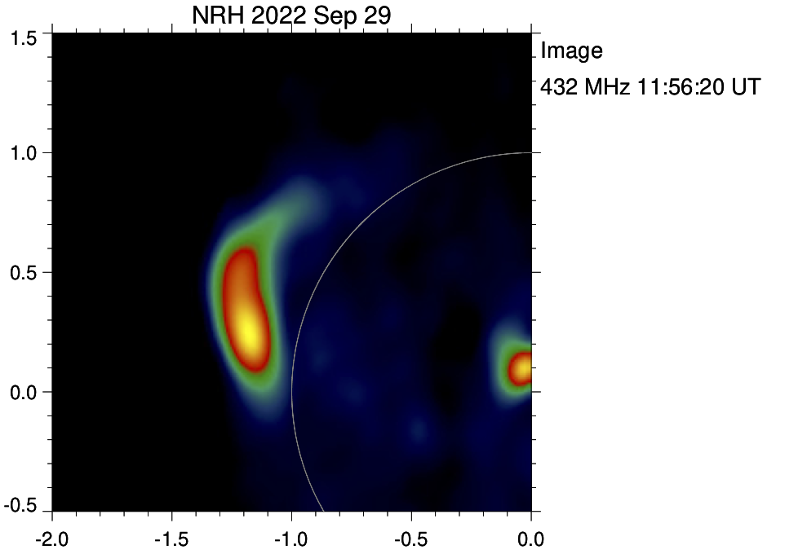
Electron acceleration and propagation
Magnetic connection in the corona
Pesce Rollins et al. 2023, Astron. Astrophys., submitted
NRH imaging: loops / flux rope connecting the AR behind the limb to the disk

Slide 7
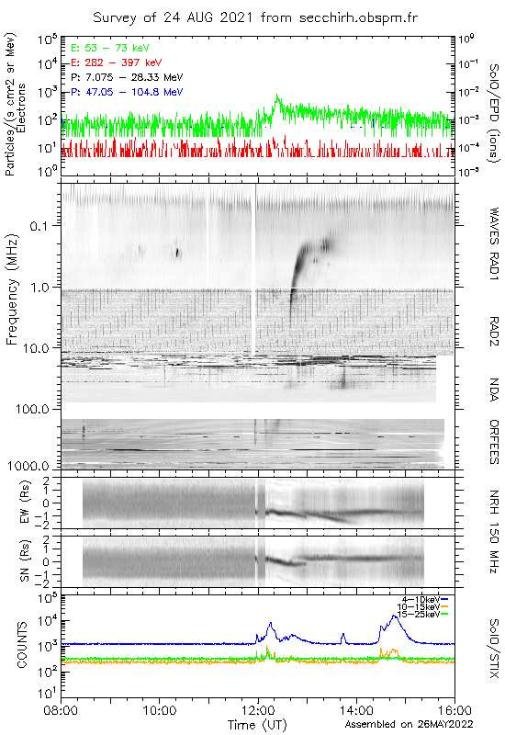
Electron acceleration, confinement, and escape
NT electrons in an erupting magnetic flux rope
Late DH III
A succession of weak solar flares (SXR), significant HXR
Radio dm-m-λ: impulsive phase + faint type IV continuum
DH-λ: late DH III burst
Weak electron event (Solar Orbiter)
www.secchirh.obspm.fr
Impulsive phase, no LF counterpart
How can one understand the delayed escape of energetic electrons (DH III, in situ) to the Heliosphere?
Faint continuum

Slide 8
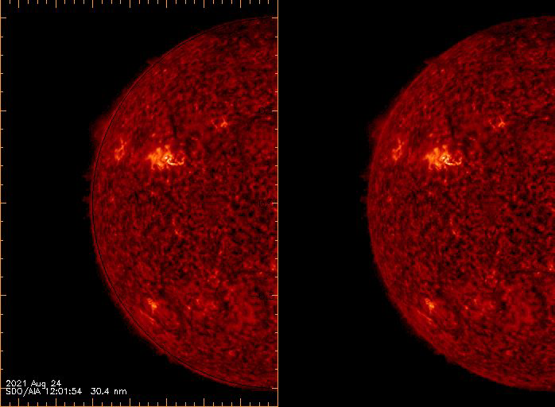
Electron acceleration, confinement, and escape
NT electrons in an erupting magnetic flux rope
SDO/AIA + NRH
Klein, Salas Matamoros & Hamini, in prep.
Faint continuum (“moving type IV burst”) = NT electrons confined in an erupting magnetic flux rope (absorbing filament material at 30.4 nm)

Slide 9
Electron acceleration, confinement, and escape
NT electrons in an erupting magnetic flux rope
DH III starts near 40 MHz
out of type IV continuum
counterparts at NRH frequencies
Imaging:
  source near moving type IV source
  => escape of confined electrons from the erupting flux rope
  mag. reconnection flux rope – ambient open mag. field (Masson et al. 2013, 2019 ApJ)
Klein, Salas Matamoros & Hamini, in prep.
Moving type IV (10 s integration)
HF DH III
counterpart (0.25 s integration)

Slide 10
Summary
Ground-based radio observations are an essential addition to achieve science goals of the Solar Orbiter mission.
After five years of work (2015-2020) the NRH provides scientifically useful observations - 90% of possible observing time covered (Stokes I).
Ongoing work:
  maintenance / replacement of power supply, antenna frontends (dipole systems) and electronics
  improved / more reliable pointing system
Our thanks to PNST for sustained support over many years!

